Slide 1

ECFSPR 2022 ANNUAL DATA REPORT
SLIDE DECK
Citation:
ECFSPR Annual Report 2022, Zolin A, Adamoli A, Bakkeheim E, van Rens J et al, 2024
If you use the graph(s) to include in your presentation:
Include the citation as above.
Consider the note(s) below the graph to understand the graph.
For information contact info@ecfregistry.eu
www.ecfs.eu/ecfspr

Slide 2
CHAPTER 1: DEMOGRAPHICS
1.1 Map of countries
1.2 Number of people with CF
1.3 Countries in ECFSPR
1.4 Age at follow-up distribution
1.5 Distribution by sex
1.6 Proportion of children and adults
1.7 People with CF and percentage of adults and children from 2008 to 20212
1.8 Age at follow-up by country and overall
1.9 Sex distribution by country and overall
CHAPTER 2: DIAGNOSIS
2.1 Age at diagnosis, <18 years
2.2 Age at diagnosis, adults
2.3 Children diagnosed <3 months or 3 months – 18 years
2.4 Adults diagnosed <3months or 3 months – 18 years
2.5 Proportion of children, underwent neonatal screening
2.6 People with CF with meconium, ileus
2.7 Neonatal screening done in people with CF 5 years old or younger in the year of follow-up from 2012 to 2022
CHAPTER 3: GENETICS
3.1 Proportion of identified variants
3.2 Prevalence of F508del homozygous and heterozygous
3.3 Map distribution of F508del variant
3.4 Map distribution of G542X variant
3.5 Map distribution of N130K variant
3.6 Map distribution of G551D variant
3.7 Map distribution of 2789+5G>A variant
CHAPTER 4: LUNG FUNCTION
4.1 FEV1% predicted, by country and overall
4.2 FEV1% predicted, descriptive statistics, by country
4.3 Median FEV1% by age group and by country
4.4 Quartiles of FEV1% by age group and by country, 6 years or older
4.5 FEV1% 6-17 years by country
4.6 FEV1% 18-29 years by country
4.7 FEV1% 30 years or older by country
4.8 Median FEV1% by age group in 2012, 2017 and 2022
CHAPTER 5: MICROBIOLOGY
5.1 Prevalence of Chronic Pseudomonas aseruginosa
5.2 Prevalence of Burkholderia cepacia complex specie
5.3 Prevalence of Haemophilus influenzae
5.4 Prevalence of Staphylococcus aureus
5.5 Prevalence of MRSA
5.6 Prevalence of Stenotrophomonas maltophilia
5.7 Prevalence of Achromobacter species infection
5.8 Prevalence of people with CF infected by Pseudomonas aeruginosa by age group in 2012, 2017 and 20212
CHAPTER 6: NUTRITION
6.1 Use of pancreatic enzymes
6.2 Median z-score for BMI 2 – 17 years by country
6.3 Quartiles of z-scores for BMI 2 – 17 years by country
6.4 Proportion of 2 – 17 years who are underweight
6.5 Proportion of adults with BMI<20 by sex and by country
6.6 Median z-score for BMI by age group in 2012, 2017 and 2022
CHAPTER 7: COMPLICATIONS
7.1 Prevalence of allergic bronchopulmonary aspergillosis
7.2 Prevalence of CFRD
7.3 Prevalence and severity of liver disease
CHAPTER 8: THERAPIES
8.1 Use of inhaled hypertonic saline
8.2 Use of rhDNase
8.3 Use of inhaled antibiotics
8.4 Use of bronchodilators
8.5 Use of macrolides
8.6 Use of oxygen
8.7 Use of inhaled steroids
8.8 Use of oral steroids
8.9 Use of ursodeoxycholic acid
8.10 Use of proton pump inhibitors
8.11 Use of therapies among adults from 2012 to 2022
8.12 Median z-score for BMI by age group in 2012, 2017 and 2022
CHAPTER 9: CFTR MODULATOR THERAPIES
9.1 Map Ivacaftor reimbursed
9.2 Map lumacaftor/ivacaftor reimbursed
9.3 Map tezacaftor/ivacaftor reimbursed
9.4 Map elexacaftor/tezacaftor/ivacaftor is licensed and reimbursed
9.5 People with CF eligible for at least one modulator, children
9.6 People with CF eligible for at least one modulator, adults
9.7 Use of CFTR modulator therapy from 2018 to 2022
CHAPTER 10: TRANSPLANTATION
10.1 People with CF living in 2021 with transplanted lungs
10.2 people with CF living in 2020 with transplanted liver
CHAPTER 11: MORTALITY
11.1 Age at death distribution of people with CF deceased in 2021
CHAPTER 12: DATA QUALITY
12.1 Data completeness in follow-up year 2022
12.2 Data accuracy for the follow-up years 2021 and 2022
www.ecfs.eu/pr

Slide 3
CHAPTER 1
DEMOGRAPHICSS
www.ecfs.eu/pr

Slide 4

Figure 1.1
Map of countries that contributed data to the ECFSPR for the year 2022.
Marked in turquoise are the countries that contributed 2022 data.
Note: BE could not provide data due to internal technical software issues and is marked in light blue
ECFSPR Annual Report 2022, Zolin A, Adamoli A, Bakkeheim E, van Rens J et al, 2024

Slide 5
Figure 1.2
The number of people with CF registered in the ECFSPR varies across countries and continues to grow.
Number of people with CF registered in the ECFSR in 2022.
ECFSPR Annual Report 2022, Zolin A, Adamoli A, Bakkeheim E, van Rens J et al, 2024

Slide 6
Figure 1.3
The number of countries and people with CF in the ECFSPR has risen continuously over the years.
Number of people with CF and number of countries from 2008 to 2022.
ECFSPR Annual Report 2022, Zolin A, Adamoli A, Bakkeheim E, van Rens J et al, 2024

Slide 7
Figure 1.4
Age distribution demonstrates a sharp decline from the third decade of life.
Distribution of age at follow-up. People with CF alive on 31/12/2022.
ECFSPR Annual Report 2022, Zolin A, Adamoli A, Bakkeheim E, van Rens J et al, 2024

Slide 8
Figure 1.5
Age distribution is significantly skewed towards childhood and adolescence in CF.
Distribution of age at follow-up (in years) by sex.
ECFSPR Annual Report 2022, Zolin A, Adamoli A, Bakkeheim E, van Rens J et al, 2024

Slide 9
Figure 1.6
The proportion of adults with CF varies considerably between European countries.
Proportion of children (<18 years) and adults (≥18 years), by country and overall. People with CF alive on 31/12/2022
ECFSPR Annual Report 2022, Zolin A, Adamoli A, Bakkeheim E, van Rens J et al, 2024

Slide 10
Figure 1.7
In recent years the proportion of adults with CF in Europe has risen significantly; as of 2022, adults made up more than >50% of the total.
Number of people with CF and percentage of adults and children from 2008 to 2022.
ECFSPR Annual Report 2022, Zolin A, Adamoli A, Bakkeheim E, van Rens J et al, 2024

Slide 11
Figure 1.8
The mean age of the CF population is not homogenous in Europe and depends on the country or region of residence.
Age at follow-up: box plot, by country and overall. People with CF alive on 31/12/2022.
ECFSPR Annual Report 2022, Zolin A, Adamoli A, Bakkeheim E, van Rens J et al, 2024

Slide 12
Figure 1.9
Sex distribution is comparatively homogenous throughout Europe except for a few countries.
Sex distribution, by country and overall. People with CF alive on 31/12/2022.
ECFSPR Annual Report 2022, Zolin A, Adamoli A, Bakkeheim E, van Rens J et al, 2024

Slide 13
CHAPTER 2
DIAGNOSIS
www.ecfs.eu/pr

Slide 14
Figure 2.1
Age at diagnosis in children and adolescents depends on various factors, including the existence or not of a newborn screening programme in the country.
Age at diagnosis (in years): boxplot, by country and overall. All children and adolescents (<18 yrs) seen in 2022.
Note: For Cyprus, Greece, Lithuania and the Slovak Republic the information on age at diagnosis is missing for more than 10% of the children.
ECFSPR Annual Report 2022, Zolin A, Adamoli A, Bakkeheim E, van Rens J et al, 2024

Slide 15
Figure 2.2
For adults, the age at diagnosis reflects national differences in the diagnostic approach over the last decades.
Age at diagnosis (in years): boxplot, by country and overall. All adults (≥ 18 years) seen in 2022 .
Note: Albania, Armenia and Georgia have <5 adults seen in 2022 and are excluded from the table, but the people are included in the total number.
Note: For Austria, Finland, Greece and Switzerland the information on age at diagnosis is missing for more than 10% of the people with CF.
ECFSPR Annual Report 2022, Zolin A, Adamoli A, Bakkeheim E, van Rens J et al, 2024

Slide 16
Figure 2.3
With the implementation of newborn screening programmes, age at diagnosis has shifted to the first 3 months of life in many countries.
Proportion of children with CF diagnosed at younger than 3 months, between 3 months and 18 years, and older than 18 years, by country and overall. All children and adolescents with CF seen in 2021.
Note: For Cyprus, Greece, Lithuania and the Slovak Republic the information on age at diagnosis is missing for more than 10% of the children..
ECFSPR Annual Report 2022, Zolin A, Adamoli A, Bakkeheim E, van Rens J et al, 2024

Slide 17
Figure 2.4
Age at diagnosis has shifted to the first 3 months of life in many countries, due to early recognition of symptoms or longer running neonatal screening programmes
Proportion of adults with CF diagnosed at younger than 3 months, between 3 months and 18 years, and older than 18 years, by country and overall. All adults with CF seen in 2022.
Note: Albania, Armenia and Georgia have <5 adults seen in 2022 and are excluded from the table, but the people are included in the total number.
Note: For Austria, Finland, Greece and Switzerland the information on age at diagnosis is missing for more than 10% of the people with CF.
ECFSPR Annual Report 2022, Zolin A, Adamoli A, Bakkeheim E, van Rens J et al, 2024

Slide 18
Figure 2.5
The proportion of young children with CF diagnosed through newborn screening has increased in many countries over the years
Proportion of children with CF who underwent neonatal screening, by country and overall. Children 5 years old or younger seen in 2022.
Note: Cyprus and Iceland have <5 children 5 years old or younger seen in 2022 and are excluded from the graph.
Note: For Belgium and Israel the information on neonatal screening is missing for more than 10% of the children ≤5 years old.
Note: For France and the United Kingdom positive answers (“neonatal screening performed”) are reported only when neonatal screening is one of the factors that led to CF diagnosis.
ECFSPR Annual Report 2022, Zolin A, Adamoli A, Bakkeheim E, van Rens J et al, 2024

Slide 19
Figure 2.6
Meconium ileus at birth is not rare and may be the first symptom of CF detected in newborns.
People with CF with meconium ileus, by country and overall. People with CF aged 10 years or younger.
ECFSPR Annual Report 2022, Zolin A, Adamoli A, Bakkeheim E, van Rens J et al, 2024

Slide 20
Figure 2.7
In the last decade the proportion of children diagnosed with CF through newborn screening has increased to almost 90% throughout Europe.
Neonatal screening done in people with CF 5 years old or younger in the year of follow-up from 2012 to 2022.
ECFSPR Annual Report 2022, Zolin A, Adamoli A, Bakkeheim E, van Rens J et al, 2024

Slide 21
CHAPTER 3
GENETICS
www.ecfs.eu/pr

Slide 22
Figure 3.1
Most of the people with CF in Europe have two CFTR variants identified.
Proportion of variants identified and not identified, by country and overall. Only people with CF for whom DNA analysis has been done.
ECFSPR Annual Report 2022, Zolin A, Adamoli A, Bakkeheim E, van Rens J et al, 2024

Slide 23
Figure 3.2
The prevalence of the F508del variant varies considerably between the countries in Europe; this has a major impact on CFTR modulator eligibility.
Prevalence of F508del homozygous and heterozygous people with CF, by country and overall. All people with CF seen in 2022.
ECFSPR Annual Report 2022, Zolin A, Adamoli A, Bakkeheim E, van Rens J et al, 2024

Slide 24
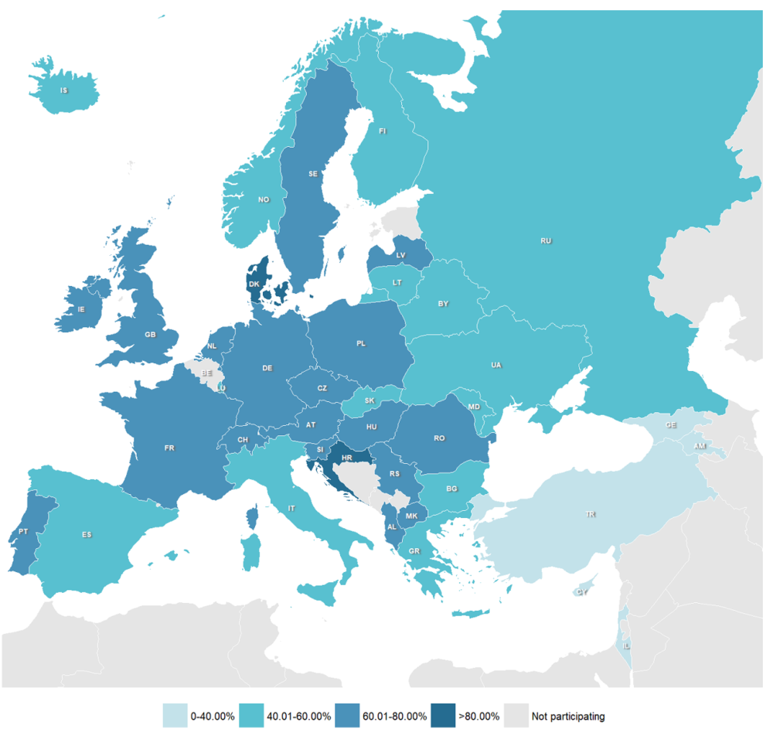
Figure 3.3
Geographical distribution of F508del variant.
ECFSPR Annual Report 2022, Zolin A, Adamoli A, Bakkeheim E, van Rens J et al, 2024

Slide 25
Figure 3.4
Geographical distribution of G542X variant.
ECFSPR Annual Report 2022, Zolin A, Adamoli A, Bakkeheim E, van Rens J et al, 2024

Slide 26
Figure 3.5
Geographical distribution of N1303K variant.
ECFSPR Annual Report 2022, Zolin A, Adamoli A, Bakkeheim E, van Rens J et al, 2024

Slide 27
Figure 3.6
Geographical distribution of G551D variant.
ECFSPR Annual Report 2022, Zolin A, Adamoli A, Bakkeheim E, van Rens J et al, 2024

Slide 28
Figure 3.7
Geographical distribution of 2789+5G->A variant.
ECFSPR Annual Report 2022, Zolin A, Adamoli A, Bakkeheim E, van Rens J et al, 2024

Slide 29
CHAPTER 4
LUNG FUNCTION
www.ecfs.eu/pr

Slide 30
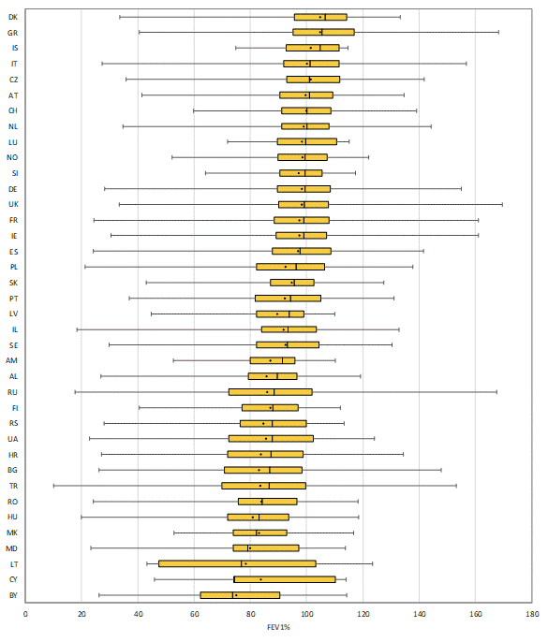
Figure 4.1
Median FEV1% of predicted of young children and adolescents with CF <18 years of age is >80% in almost all countries in Europe.
FEV1% of predicted: boxplot by country. Children and adolescents with CF aged 6-17 years who have never had an organ transplant, seen in 2022.
Note: Georgia has <5 individuals aged 6-17 years at the date of FEV1 measurement and is excluded from the graph.
Note: Sweden and the United Kingdom report FEV1 from the annual review, which might not be the best FEV1 of the year, and, in some cases, the FEV1 measurement could be from the previous calendar year
ECFSPR Annual Report 2022, Zolin A, Adamoli A, Bakkeheim E, van Rens J et al, 2024

Slide 31
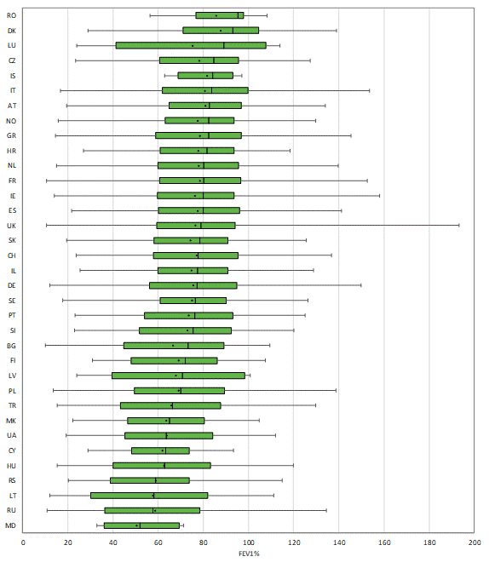
Figure 4.2
Median FEV1% of predicted of adults with CF varies between <60% and >90% depending on the country.
FEV1% of predicted: boxplot by country. Adults with CF who have never had a transplant, seen in 2022.
Note: Albania, Armenia, Belarus and Georgia have <5 adults with FEV1 measurement and are excluded from the table, but the people are included in the total number.
Note: Sweden and the United Kingdom report FEV1 from the annual review, which might not be the best FEV1 of the year and, in some cases, the FEV1 measurement could be from the previous calendar year.
ECFSPR Annual Report 2022, Zolin A, Adamoli A, Bakkeheim E, van Rens J et al, 2024

Slide 32
Figure 4.3
Lung function declines between the third and fifth decade of life but stabilises in older people with CF.
Median FEV1% of predicted by age group and by country.
Note: We excluded from the graph those age groups where the number of individuals was <10.
ECFSPR Annual Report 2022, Zolin A, Adamoli A, Bakkeheim E, van Rens J et al, 2024

Slide 33
Figure 4.4
Decline in lung function over time in adults with CF still poses a challenge in Europe.
Quartiles of FEV1% of predicted by age group and by country. People with CF aged 6 years or older and who have never had a transplant.
ECFSPR Annual Report 2022, Zolin A, Adamoli A, Bakkeheim E, van Rens J et al, 2024

Slide 34
Figure 4.4
Decline in lung function over time in adults with CF still poses a challenge in Europe.
Quartiles of FEV1% of predicted by age group and by country. People with CF aged 6 years or older and who have never had a transplant.
ECFSPR Annual Report 2022, Zolin A, Adamoli A, Bakkeheim E, van Rens J et al, 2024

Slide 35
Figure 4.4
Decline in lung function over time in adults with CF still poses a challenge in Europe.
Quartiles of FEV1% of predicted by age group and by country. People with CF aged 6 years or older and who have never had a transplant.
ECFSPR Annual Report 2022, Zolin A, Adamoli A, Bakkeheim E, van Rens J et al, 2024

Slide 36
Figure 4.4
Lung function decline over time in adults with CF still poses a challenge in Europe.
Quartiles of FEV1% of predicted by age group and by country. People with CF aged 6 years or older and who have never had a transplant.
ECFSPR Annual Report 2022, Zolin A, Adamoli A, Bakkeheim E, van Rens J et al, 2024

Slide 37
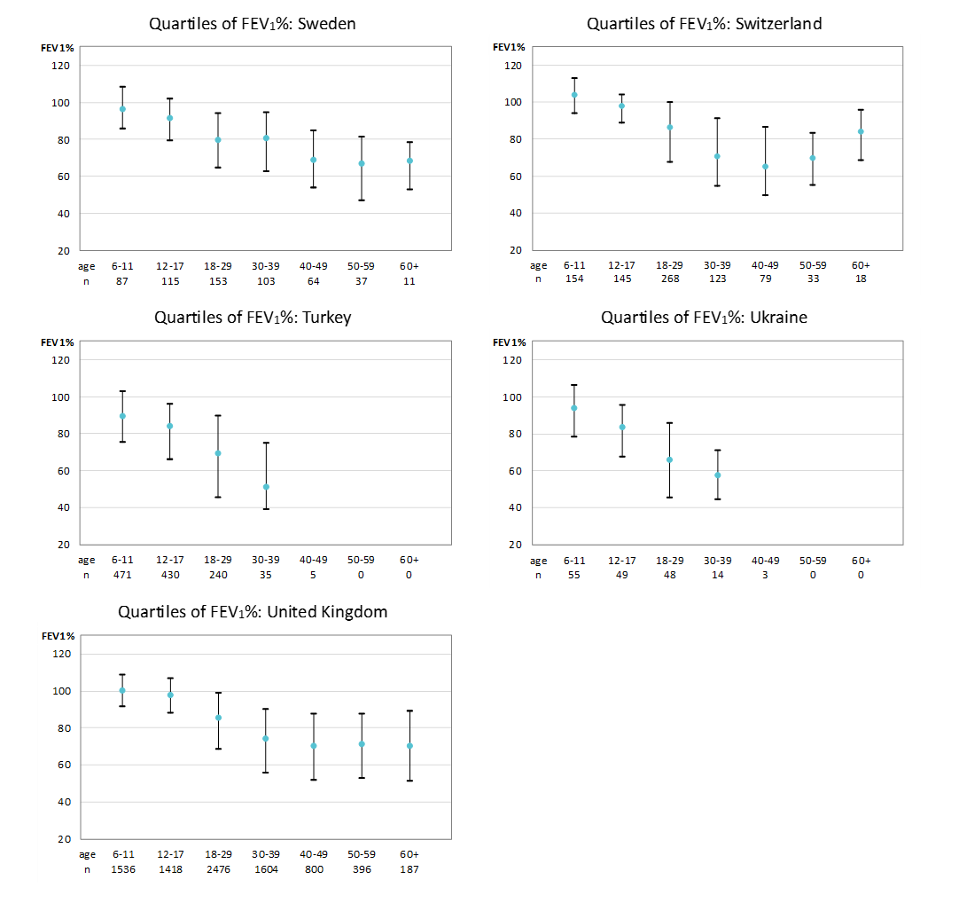
Figure 4.4
Decline in lung function over time in adults with CF still poses a challenge in Europe.
Quartiles of FEV1% of predicted by age group and by country. People with CF aged 6 years or older and who have never had a transplant.
Note: Sweden and the United Kingdom report FEV1 from the annual review, which might not be the best FEV1 of the year and, in some cases, the FEV1 measurement could be from the previous calendar year.
ECFSPR Annual Report 2022, Zolin A, Adamoli A, Bakkeheim E, van Rens J et al, 2024

Slide 38
Figure 4.5
The majority of all children and adolescents with CF in Europe have a FEV1 of >80% predicted.
FEV1% of predicted according to severity group and age group, by country. Children and adolescents with CF aged 6 – 17 years who have never had a transplant.
Note: Georgia has <5 people with CF aged 6-17 years at FEV1 measurement and is excluded from the graph.
Note: Sweden and the United Kingdom reports FEV1 from the annual review, which might not be the best FEV1 of the year, and, in some cases, the FEV1 measurement could be from the previous calendar year.
ECFSPR Annual Report 2022, Zolin A, Adamoli A, Bakkeheim E, van Rens J et al, 2024

Slide 39
Figure 4.6
In the majority of countries, the proportion of young adults with CF with a FEV1% of predicted below 40% is less than 10-20%.
FEV1% of predicted according to severity group and age group, by country. Adults with CF aged 18 – 29 years who have never had a transplant.
Note: Albania, Armenia, Belarus, Georgia, Iceland, Luxembourg and Rep of Moldova have <5 people aged 18-29 years with FEV1 measurement and are excluded from the graph.
Note: Sweden and the United Kingdom report FEV1 from the annual review, which might not be the best FEV1 of the year, and, in some cases, the FEV1 measurement could be from the previous calendar year.
ECFSPR Annual Report 2022, Zolin A, Adamoli A, Bakkeheim E, van Rens J et al, 2024

Slide 40
Figure 4.7
In the majority of countries, most adults with CF aged 30 years or older have a FEV1% of predicted between 40% and 80%.
FEV1% of predicted according to severity group and age group, by country and overall. Adults with CF aged 30 years or older who have never had a transplant.
Note: Albania, Armenia, Belarus, Georgia, Iceland, Latvia, Luxembourg, Rep of Moldova, and Romania have <5 people aged 30 years or more with FEV1 measurement and are excluded from the graph.
Note: Sweden and the United Kingdom report FEV1 from the annual review, which might not be the best FEV1 of the year and, in some cases, the FEV1 measurement could be from the previous calendar year.
ECFSPR Annual Report 2022, Zolin A, Adamoli A, Bakkeheim E, van Rens J et al, 2024

Slide 41
Figure 4.8
Pulmonary function, expressed as FEV1% of predicted, has been increasing over the years in all age groups, with a clear improvement since the introduction of CFTR modulators.
Median FEV1% by age group in 2012, 2017 and 2022.
Note: People with CF aged 6 years or more at lung function measurement, who have never had a lung or liver transplant.
ECFSPR Annual Report 2022, Zolin A, Adamoli A, Bakkeheim E, van Rens J et al, 2024

Slide 42
CHAPTER 5
MICROBIOLOGY
www.ecfs.eu/pr

Slide 43
Figure 5.1
Pseudomonas aeruginosa, together with Staphylococcus aureus and Haemophilus influenzae, is the predominant respiratory pathogen in people with CF, though prevalence varies between age and countries
Prevalence of Chronic Pseudomonas aeruginosa in people with CF seen in 2022 who have never had a transplant, by country.
Note: We excluded from the graph the countries for which the information is missing for more than 10% of the children/adults. Albania, Armenia, and Georgia have <5 adults seen in 2022 and are excluded from the graph for adults.
Note: Ireland and Italy: chronicity for Pseudomonas aeruginosa is defined as: at least 3 or more positive isolates during the last 12 months preceding the last reported culture in 2022.
Note: The United Kingdom: chronicity for Pseudomonas aeruginosa is defined as: 3 or more positive isolates during the 12 months preceding the last annual review.
ECFSPR Annual Report 2022, Zolin A, Adamoli A, Bakkeheim E, van Rens J et al, 2024

Slide 44
Figure 5.2
Burkholderia cepacia complex species belong to the emerging respiratory pathogens with increasing prevalence in some countries.
Prevalence of chronic Burkholderia cepacia complex species in people with CF seen in 2022 who have never had a transplant, by country
Note: We excluded from the graph the countries for which the information is missing for more than 10% of the children/adults. Albania, Armenia, and Georgia have <5 adults seen in 2022 and are excluded from the graph for adults.
Note: Ireland and Italy: chronicity for Burkholderia cepacia complex is defined as: at least 3 or more positive isolates during the last 12 months preceding the last reported culture in 2022.
Note: The United Kingdom: chronicity for Burkholderia cepacia complex is not collected.
ECFSPR Annual Report 2022, Zolin A, Adamoli A, Bakkeheim E, van Rens J et al, 2024

Slide 45
Figure 5.3
Haemophilus influenzae, together with Pseudomonas aeruginosa and Staphylococcus aureus, is the predominant respiratory pathogen in people with CF, though prevalence varies between age and countries.
Prevalence of Haemophilus influenzae (not chronic) in people with CF seen in 2022 who have never had a transplant, by country.
Note: We excluded from the graph the countries for which the information is missing for more than 10% of the children/adults. Albania, Armenia and Georgiahave <5 adults seen in 2022 and are excluded from the graph for adults.
Note: Belgium, France, Germany and United Kingdom: chronicity for Haemophilus influenza is not collected.
Note: Ireland and Italy: chronicity for Haemophilus influenzae is defined as: at least 3 or more positive isolates during the last 12 months preceding the last reported culture in 2022.
ECFSPR Annual Report 2022, Zolin A, Adamoli A, Bakkeheim E, van Rens J et al, 2024

Slide 46
Figure 5.4
Staphylococcus aureus, together with Pseudomonas aeruginosa and Haemophilus influenzae, is the predominant respiratory pathogen in people with CF, though prevalence varies between age and countries.
Prevalence of Staphylococcus aureus in people with CF seen in 2022 who have never had a transplant, by country.
Note: We excluded from the graph the countries for which the information is missing for more than 10% of the children/adults. Albania, Armenia Georgia have <5 adults seen in 2022 and are excluded from the graph for adults.
Note: Ireland and Italy: chronicity for Staphylococcus Aureus is defined as: at least 3 or more positive isolates during the last 12 months preceding the last reported culture in 2022.
Note: The United Kingdom: chronicity for Staphylococcus Aureus is defined as: 3 or more positive isolates during the 12 months preceding the last annual review.
ECFSPR Annual Report 2022, Zolin A, Adamoli A, Bakkeheim E, van Rens J et al, 2024

Slide 47
Figure 5.5
Prevalence of methicillin-resistant Staphylococcus aureus (MRSA) in the airways is very heterogeneous in people with CF throughout Europe.
Prevalence of methicillin-resistant Staphylococcus aureus (MRSA) in people with CF seen in 2022 who have never had a transplant, by country.
Note: We excluded from the graph the countries for which the information is missing for more than 10% of the children/adults. Albania, Armenia Georgia have <5 adults seen in 2022 and are excluded from the graph for adults.
Note: Ireland and Italy: chronicity for methicillin-resistant Staphylococcus Aureus is defined as: at least 3 or more positive isolates during the last 12 months preceding the last reported culture in 2022.
Note: The United Kingdom: chronicity for methicillin-resistant Staphylococcus Aureus is not collected.
ECFSPR Annual Report 2022, Zolin A, Adamoli A, Bakkeheim E, van Rens J et al, 2024

Slide 48
Figure 5.6
In the majority of countries, Stenotrophomonas maltophilia is found in a significant number of airway samples in children and adults with CF.
Prevalence of Stenotrophomonas maltophilia (not chronic) in people with CF seen in 2022 who have never had a transplant, by country.
Note: We excluded from the graph the countries for which the information is missing for more than 10% of the children/adults. Albania, Armenia and Georgia have <5 adults seen in 2022 and are excluded from the graph for adults.
Note: Ireland and Italy: chronicity for Stenotrophomonas maltophilia is defined as: at least 3 or more positive isolates during the last 12 months preceding the last reported culture in 2022.
Note: The United Kingdom: chronicity for Stenotrophomonas maltophilia is not collected.
ECFSPR Annual Report 2022, Zolin A, Adamoli A, Bakkeheim E, van Rens J et al, 2024

Slide 49
Figure 5.7
Achromobacter species can be found in up to 20% of the airways of people with CF, with a higher prevalence in adults.
Prevalence of Achromobacter species infection (not chronic) in people with CF seen in 2022 who have never had a transplant, by country.
Note: We excluded from the graph the countries for which the information is missing for more than 10% of the children/adults. Albania, and Georgia have <5 adults seen in 2022 and are excluded from the graph for adults.
Note: Ireland and Italy: chronicity for Achromobacter species is defined as: at least 3 or more positive isolates during the last 12 months preceding the last reported culture in 2022.
Note: The United Kingdom: chronicity for Achromobacter species is not collected.
ECFSPR Annual Report 2022, Zolin A, Adamoli A, Bakkeheim E, van Rens J et al, 2024

Slide 50
Figure 5.8
The prevalence of Pseudomonas aeruginosa infection has decreased in the CF population in Europe since increased availability of CFTR modulators.
Prevalence of people with CF infected by Pseudomonas aeruginosa by age group in 2012, 2017 and 2022.
ECFSPR Annual Report 2022, Zolin A, Adamoli A, Bakkeheim E, van Rens J et al, 2024

Slide 51
CHAPTER 6
NUTRITION
www.ecfs.eu/pr

Slide 52
Figure 6.1
In the majority of countries, more than 80% of the people with CF are pancreatic insufficient.
Use of pancreatic enzymes in 2022 for all people with CF who have never had a transplant, by country.
ECFSPR Annual Report 2022, Zolin A, Adamoli A, Bakkeheim E, van Rens J et al, 2024

Slide 53
Figure 6.2
While the median BMI z-score for children and adolescents with CF in Europe is close to normal for all age groups, a lot of variation amongst the countries can be observed.
Median z-score for BMI by age group and by country. Children and adolescents with CF aged 2-17 years in 2022 who have never had a transplant.
Note: We excluded from the graph those age groups where the number of individuals was <10.
ECFSPR Annual Report 2022, Zolin A, Adamoli A, Bakkeheim E, van Rens J et al, 2024

Slide 54
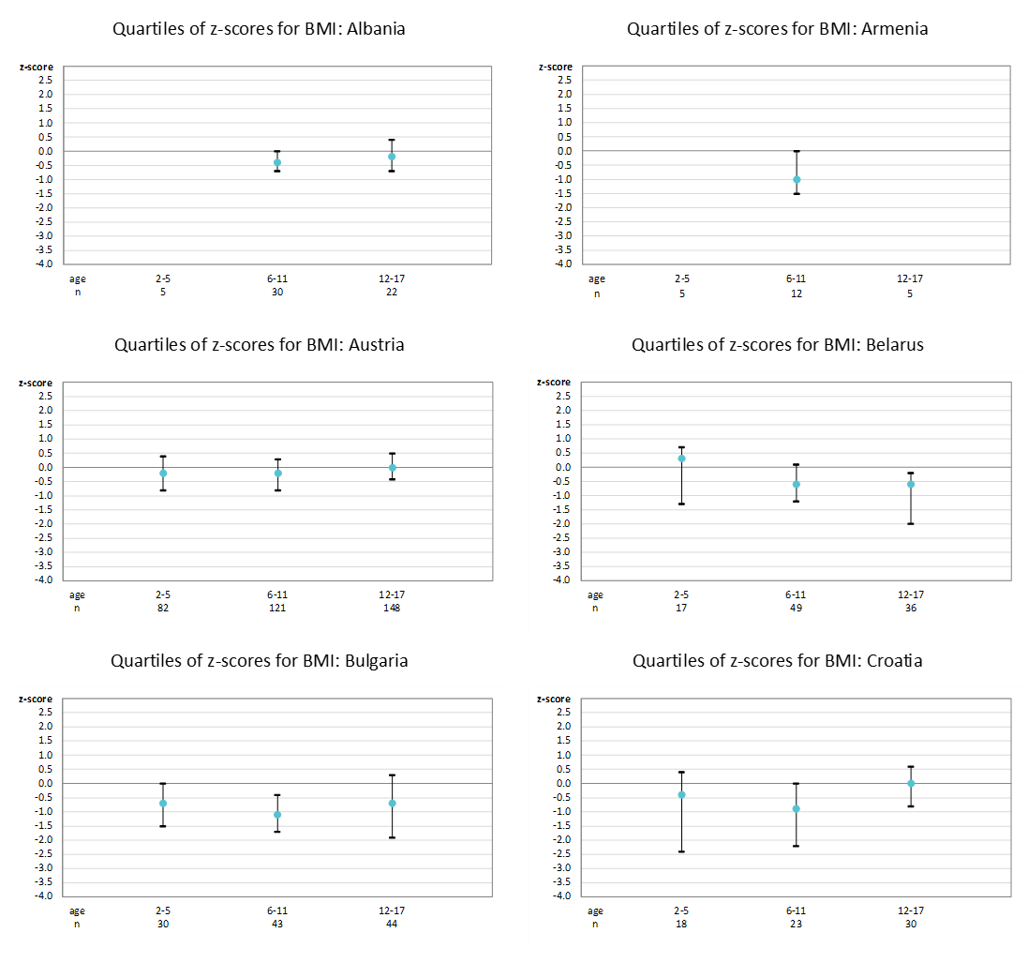
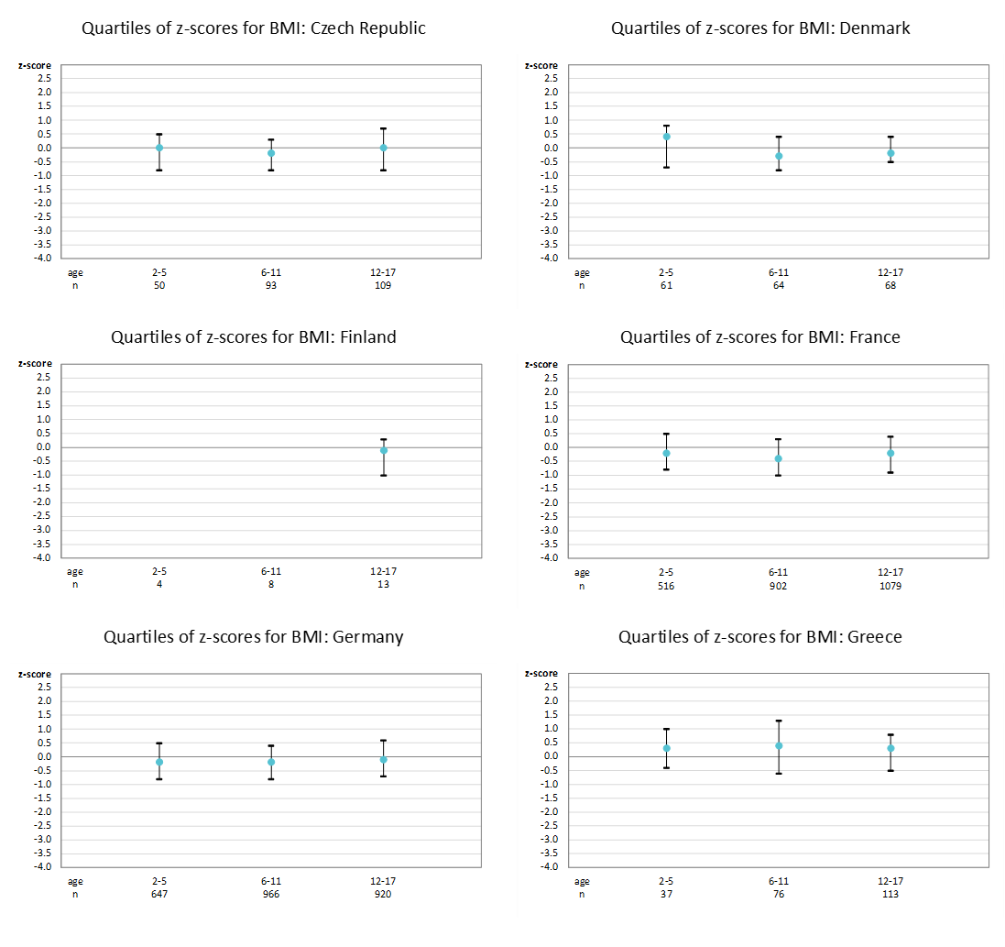
Figure 6.3
The median BMI of children and adolescents with CF is influenced by age and country of residence.
Quartiles of z-scores for BMI by age group and country. Children and adolescents with CF aged 2-17 years in 2022 who have never had a transplant.
ECFSPR Annual Report 2022, Zolin A, Adamoli A, Bakkeheim E, van Rens J et al, 2024

Slide 55
Figure 6.3
The median BMI of children and adolescents with CF is influenced by age and country of residence.
Quartiles of z-scores for BMI by age group and country. Children and adolescents with CF aged 2-17 years in 2022 who have never had a transplant.
ECFSPR Annual Report 2022, Zolin A, Adamoli A, Bakkeheim E, van Rens J et al, 2024

Slide 56
Figure 6.3
The median BMI of children and adolescents with CF is influenced by age and country of residence.
Quartiles of z-scores for BMI by age group and country. Children and adolescents with CF aged 2-17 years in 2022 who have never had a transplant.
ECFSPR Annual Report 2022, Zolin A, Adamoli A, Bakkeheim E, van Rens J et al, 2024

Slide 57
Figure 6.3
The median BMI of children and adolescents with CF is influenced by age and country of residence.
Quartiles of z-scores for BMI by age group and country. Children and adolescents with CF aged 2-17 years in 2022 who have never had a transplant.
ECFSPR Annual Report 2022, Zolin A, Adamoli A, Bakkeheim E, van Rens J et al, 2024

Slide 58
Figure 6.4
Being underweight is a hallmark clinical feature in children and adolescents with CF. There are considerable differences amongst the countries.
Proportion of children and adolescents with CF who are underweight (z-score of BMI <-2) by sex and by country; aged 2-17 years in 2022 who have never had a transplant.
Note: We excluded from the graph the countries for which the information on underweight children and young people is missing for more than 10% of the individuals.
Note: Cyprus, Georgia and Iceland been excluded from this graph because the number of children in one of the sex groups is less than 5
ECFSPR Annual Report 2022, Zolin A, Adamoli A, Bakkeheim E, van Rens J et al, 2024

Slide 59
Figure 6.5
Being underweight is a hallmark clinical feature in adults with CF. There are considerable differences amongst the countries.
Proportion of adults with BMI<20 by sex and by country; aged 18 years or older in 2022 who never had a transplant.
Note: We excluded from the graph the countries for which the information on underweight adults is missing for more than 10% of the individuals.
Note: Albania, Armenia, Belarus, Cyprus, Iceland, Luxembourg and Republic of Moldova been excluded from this graph because the number of adults in one of the sex groups is less than 5.
ECFSPR Annual Report 2022, Zolin A, Adamoli A, Bakkeheim E, van Rens J et al, 2024

Slide 60
Figure 6.6
A significant improvement in BMI in 2022 from the age of 6 years is a reflection of the efficacy of CFTR modulator therapy in Europe.
Median z-score for BMI by age group in 2012, 2017 and 2022.
Note: Only people with CF aged 2 years or more at measurements, who have never had a lung or liver transplant.
ECFSPR Annual Report 2022, Zolin A, Adamoli A, Bakkeheim E, van Rens J et al, 2024

Slide 61
CHAPTER 7
COMPLICATIONS
www.ecfs.eu/pr

Slide 62
Figure 7.1
ABPA may be difficult to diagnose and report. In the ECFSPR the registered ABPA prevalence is lower in children than in adults.
Prevalence of allergic bronchopulmonary aspergillosis in children and adults seen in 2022 who have never had a transplant, by country.
Note: We excluded from the graph the countries for which the information on allergic bronchopulmonary aspergillosis (ABPA) is missing for more than 10% of the people with CF.
Note: Albania, Armenia and Georgia have <5 adults seen in 2022 and are excluded from the graph for adults.
ECFSPR Annual Report 2022, Zolin A, Adamoli A, Bakkeheim E, van Rens J et al, 2024

Slide 63
Figure 7.2
Important differences in the prevalence of CF-related diabetes in adults with CF throughout Europe might reflect genetic backgrounds but could also be linked to life expectancy.
Prevalence of CFRD, by country. All adults with CF seen in 2022 aged 18 years or older who have never had a transplant .
Note: We excluded from the graph the countries for which the information on CFRD is missing for more than 10% of the adults.
Note: Albania, Armenia and Georgia have <5 adults seen in 2022 and are excluded from the graph for adults.
ECFSPR Annual Report 2022, Zolin A, Adamoli A, Bakkeheim E, van Rens J et al, 2024

Slide 64
Figure 7.3
The prevalence of liver disease with or without cirrhosis is heterogenous across the countries in Europe.
Prevalence and severity of liver disease in children (<18 years) and adults (≥ 18 years) with CF seen in 2022 who have never had a transplant, by country
Note: We excluded from the graph the countries for which the information on liver disease is missing for more than 10% of the children/adults with CF. Albania, Armenia and Georgia have <5 adults seen in 2022 and are excluded from the graph for adults.
Note: Germany: Germany: oesophageal variceal bleeding is reported.
Note: Serbia: cirrhosis without portal hypertension/hypersplenism means the presence of ultrasound changes in liver tissue and/or abnormal liver function tests.
ECFSPR Annual Report 2022, Zolin A, Adamoli A, Bakkeheim E, van Rens J et al, 2024

Slide 65
CHAPTER 8
THERAPIES
www.ecfs.eu/pr

Slide 66
Figure 8.1
Variation in the use of inhaled hypertonic saline indicates both inequalities and different therapeutic approaches.
Use of inhaled hypertonic saline in children and adults seen in 2022 who have never had a transplant, by country
Note: We excluded from the graph the countries for which the information on inhaled hypertonic saline is missing for more than 10% of the children/adults with CF. Albania, Armenia and Georgia have <5 adults seen in 2022 and are excluded from the graph for adults.
Note: Inhaled hypertonic saline is reimbursed in most countries except in Albania, Armenia, Bulgaria, Georgia, Lithuania, the Republic of Moldova, Poland and Romania. In Ukraine it is reimbursed for children, and in Turkey for children ≥ 6 years.
ECFSPR Annual Report 2022, Zolin A, Adamoli A, Bakkeheim E, van Rens J et al, 2024

Slide 67
Figure 8.2
Variation in the use of rhDNAse indicates both inequalities in availability and different therapeutic approaches.
Use of rhDNase in children and adults seen in 2022 who have never had a transplant, by country
Note: We excluded from the graph the countries for which the information on rhDNase is missing for more than 10% of the children/adults with CF. Albania, Armenia and Georgia have <5 adults seen in 2022 and are excluded from the graph for adults.
Note: Inhaled rhDNase is reimbursed in most countries except in Albania, Armenia, Belarus and the Republic of Moldova. It is reimbursed in Georgia for people with CF ≥ 2 years; in Bulgaria, Germany, Luxembourg, Macedonia, Norway, Romania, Spain, Ukraine and the United Kingdom for individuals ≥ 5 years; in Latvia for individuals ≥ 6 years.
ECFSPR Annual Report 2022, Zolin A, Adamoli A, Bakkeheim E, van Rens J et al, 2024

Slide 68
Figure 8.3
Inhaled antibiotics are still an important therapeutic strategy in the prevention of pulmonary exacerbations, especially in adults with CF.
Use of inhaled antibiotics in children and adults seen in 2022 who have never had a transplant, by country.
Note: We excluded from the graph the countries for which the information on inhaled antibiotics is missing for more than 10% of the children/adults with CF. Albania, Armenia and Georgia have <5 adults seen in 2022 and are excluded from the graph for adults.
Note: Inhaled antibiotics are reimbursed in all countries. In Armenia only Gentamycin and in Romania only Tobramycin solution and Colistin dry powder are reimbursed.
ECFSPR Annual Report 2022, Zolin A, Adamoli A, Bakkeheim E, van Rens J et al, 2024

Slide 69
Figure 8.4
Bronchodilators (both short and long acting) are used as widespread supportive treatment in many countries in Europe.
Use of bronchodilators (both short and long acting) in children and adults seen in 2022 who have never had a transplant, by country.
Note: We excluded from the graph the countries for which the information on the use of bronchodilators is missing for more than 10% of the children/adults with CF. Albania, Armenia and Georgia have <5 adults seen in 2022 and are excluded from the graph for adults.
Note: Inhaled bronchodilators are reimbursed in most countries except in Bulgaria, Georgia, Poland and Serbia. In Ukraine they are reimbursed for children.
ECFSPR Annual Report 2022, Zolin A, Adamoli A, Bakkeheim E, van Rens J et al, 2024

Slide 70
Figure 8.5
Azithromycin is widely used as an antibiotic and anti-inflammatory mediator throughout Europe, mostly by adults with CF.
Use of macrolides in children and adults seen in 2022 who have never had a transplant, by country.
Note: We excluded from the graph the countries for which the information on the use of macrolides is missing for more than 10% of the children/adults with CF. Albania, Armenia and Georgia have <5 adults seen in 2022 and are excluded from the graph for adults.
Note: Oral macrolides are reimbursed in most countries except in Bulgaria, Georgia and Serbia. In the Republic of Moldova, they are reimbursed for children. Inhaled macrolides are reimbursed in Denmark, Germany, Slovenia and the UK.
ECFSPR Annual Report 2022, Zolin A, Adamoli A, Bakkeheim E, van Rens J et al, 2024

Slide 71
Figure 8.6
Oxygen treatment, an indicator of severe lung disease, is prescribed in up to 22% of people with CF, mostly in the adult population.
Use of oxygen in children and adults seen in 2022 who have never had a transplant, by country.
Note: We excluded from the graph the countries for which the information on the use of oxygen is missing for more than 10% of the children/adults with CF. Albania, Armenia and Georgia have <5 adults seen in 2022 and are excluded from the graph for adults.
Note: Oxygen therapy is reimbursed in most countries except in Bulgaria and the Republic of Moldova. In Armenia and Georgia it is only reimbursed if the individual is hospitalised; in Serbia therapy at home is reimbursed.
ECFSPR Annual Report 2022, Zolin A, Adamoli A, Bakkeheim E, van Rens J et al, 2024

Slide 72
Figure 8.7
Pulmonary inflammation, including obstructive symptoms, is often treated with corticosteroids.
Use of inhaled steroids in children and adults seen in 2022 who have never had a transplant, by country.
Note: We excluded from the graph the countries for which the information on use of inhaled steroids is missing for more than 10% of the children and adults with CF. Albania, Armenia and Georgia have <5 adults seen in 2022 and are excluded from the graph for adults.
Note: Inhaled steroids are reimbursed in most countries except in Armenia, Georgia, Lithuania, Poland and Serbia. In the Republic of Moldova, they are reimbursed for children. In Bulgaria they are reimbursed for people also diagnosed with asthma or chronic obstructive pulmonary disease (COPD).
ECFSPR Annual Report 2022, Zolin A, Adamoli A, Bakkeheim E, van Rens J et al, 2024

Slide 73
Figure 8.8
Pulmonary inflammation, including obstructive symptoms, is often treated with corticosteroids.
Use of oral steroids in children and adults seen in 2022 who have never had a transplant, by country
Note: We excluded from the graph the countries for which the information on use of inhaled steroids is missing for more than 10% of the children and adults with CF. Albania, Armenia and Georgia have <5 adults seen in 2022 and are excluded from the graph for adults.
Note: Inhaled steroids are reimbursed in most countries except in Armenia, Georgia, Lithuania, Poland and Serbia. In the Republic of Moldova, they are reimbursed for children. In Bulgaria they are reimbursed for people also diagnosed with asthma or chronic obstructive pulmonary disease (COPD).
ECFSPR Annual Report 2022, Zolin A, Adamoli A, Bakkeheim E, van Rens J et al, 2024

Slide 74
Figure 8.9
Ursodeoxycholic acid is often prescribed to treat cholestasis or liver disease in people with CF.
Use of ursodeoxycholic acid in children and adults seen in 2022 who have never had a transplant, by country
Note: We excluded from the graph the countries for which the information on oral ursodeoxycholic acid use is missing for more than 10% of the children/adults with CF. Albania, Armenia and Georgia have <5 adults seen in 2022 and are excluded from the graph for adults.
Note: Oral ursodeoxycholic acid is reimbursed in most countries in Europe, except in Armenia, Bulgaria, Georgia, Lithuania and Serbia. In the Republic of Moldova, it is reimbursed for children and for 70% for adults..
ECFSPR Annual Report 2022, Zolin A, Adamoli A, Bakkeheim E, van Rens J et al, 2024

Slide 75
Figure 8.10
Proton Pump Inhibitors are used to treat gastroesophageal reflux or gastritis, both common complications in CF, or to enhance pancreatic enzyme efficacy.
Use of proton pump inhibitors (PPI) in children and adults seen in 2022 who have never had a transplant, by country
Note: We excluded from the graph the countries for which the information on the use of PPI is missing for more than 10% of the children/adults with CF. Albania, Armenia and Georgia have <5 adults seen in 2022 and are excluded from the graph for adults.
Note: Oral proton pump inhibitors are reimbursed in most countries except in Bulgaria, Georgia, Lithuania, the Republic of Moldova and Serbia.
ECFSPR Annual Report 2022, Zolin A, Adamoli A, Bakkeheim E, van Rens J et al, 2024

Slide 76
Figure 8.11
Increased use of CFTR modulators in children with CF in Europe goes hand in hand with a decrease in the prescription of azithromycin and inhaled antibiotics, while the prevalence of inhaled mucolytics remains mostly unchanged.
Use of therapies among adults from 2012 to 2022.
ECFSPR Annual Report 2022, Zolin A, Adamoli A, Bakkeheim E, van Rens J et al, 2024

Slide 77
Figure 8.12
Increased use of CFTR modulators in adults with CF in Europe goes hand in hand with a decrease in the prescription of azithromycin and inhaled antibiotics, while the prevalence of inhaled mucolytics remains mostly unchanged.
Median z-score for BMI by age group in 2012, 2017 and 2022.
ECFSPR Annual Report 2022, Zolin A, Adamoli A, Bakkeheim E, van Rens J et al, 2024

Slide 78
CHAPTER 9
CFTR MODULATOR THERAPIES
www.ecfs.eu/pr

Slide 79
Figure 9.1
Countries where ivacaftor was licensed and reimbursed in 2022.
Note: - Iceland: ivacaftor is reimbursed for people with CF with the variant F508del and/or G551D. - Israel: ivacaftor is not reimbursed for people with CF with the variant R117H. - Norway: ivacaftor is reimbursed for children with CF if ≥ 5 kg. - United Kingdom:Ivacaftor is reimbursed for people with CF with the variant R117H if ≥ 6 months old..
ECFSPR Annual Report 2022, Zolin A, Adamoli A, Bakkeheim E, van Rens J et al, 2024

Slide 80
Figure 9.2
Countries where lumacaftor/ivacaftor was reimbursed in year 2022.
Note: Spain: lumacaftor/ivacaftor is reimbursed for people with CF who are between 2 and 5 years old.
Russian Federation: lumacaftor/ivacaftor is reimbursed for people with CF between 2 and 18 years old.
ECFSPR Annual Report 2022, Zolin A, Adamoli A, Bakkeheim E, van Rens J et al, 2024

Slide 81
Figure 9.3
Countries where tezacaftor/ivacaftor was reimbursed in year 2022.
ECFSPR Annual Report 2022, Zolin A, Adamoli A, Bakkeheim E, van Rens J et al, 2024

Slide 82
Figure 9.4
Countries where elexacaftor/tezacaftor/ivacaftor is licensed and reimbursed in year 2022.
Note: France: from December 2022 elexacaftor/tezacaftor/ivacaftor is reimbursed from the age of 6 years.
Russian Federation: elexacaftor/tezacaftor/ivacaftor is reimbursement for people with CF between 6 and 18 years old.
ECFSPR Annual Report 2022, Zolin A, Adamoli A, Bakkeheim E, van Rens J et al, 2024

Slide 83
Figure 9.5
Elexacaftor/tezacaftor/ivacaftor is the CFTR modulator most commonly used in children, followed by lumacaftor/ivacaftor.
Children and adolescents with CF (<18 years), eligible for and treated with at least one modulator, by country and last CFTR modulator prescribed, seen in 2022 and who have never had a transplant.
Note: Armenia, Cyprus and Georgia have <5 eligible children seen in 2022 and are excluded from the graph..
ECFSPR Annual Report 2022, Zolin A, Adamoli A, Bakkeheim E, van Rens J et al, 2024

Slide 84
Figure 9.6
In the majority of countries in Europe, the majority of all adults with CF are eligible to receive a CFTR modulator treatment.
Adults with CF (≥18 years), eligible for and treated with at least one modulator, by country and last CFTR modulator prescribed, seen in 2022 and who have never had a transplant.
Note: Albania, Armenia, Belarus, Georgia and Luxembourg have <5 eligible adults seen in 2022 and are excluded from the graph..
ECFSPR Annual Report 2022, Zolin A, Adamoli A, Bakkeheim E, van Rens J et al, 2024

Slide 85
Figure 9.7
A widening of the eligibility criteria and increased reimbursement for CFTR modulators in Europe means a considerable increase in their use from 2020 onwards.
Use of CFTR modulator therapy from 2018 to 2022.
ECFSPR Annual Report 2022, Zolin A, Adamoli A, Bakkeheim E, van Rens J et al, 2024

Slide 86
CHAPTER 10
TRANSPLANTATION
www.ecfs.eu/pr

Slide 87
Figure 10.1
The number and proportion of people with CF living with a lung transplant is extremely heterogenous across Europe.
Number of people with CF living in 2022 with transplanted lungs, by country.
ECFSPR Annual Report 2022, Zolin A, Adamoli A, Bakkeheim E, van Rens J et al, 2024

Slide 88
Figure 10.2
The number and proportion of people with CF living with a liver transplant is extremely heterogenous throughout Europe.
Number of people with CF living in 2022 with transplanted liver, by country.
ECFSPR Annual Report 2022, Zolin A, Adamoli A, Bakkeheim E, van Rens J et al, 2024

Slide 89
CHAPTER 11
MORTALITY
www.ecfs.eu/pr

Slide 90
Figure 11.1
Most of the deaths occur between the third and the fifth decade of life in people with CF in Europe.
Age at death distribution of people with CF deceased in 2022, by sex.
ECFSPR Annual Report 2022, Zolin A, Adamoli A, Bakkeheim E, van Rens J et al, 2024

Slide 91
CHAPTER 12
DATA QUALITY
www.ecfs.eu/pr

Slide 92
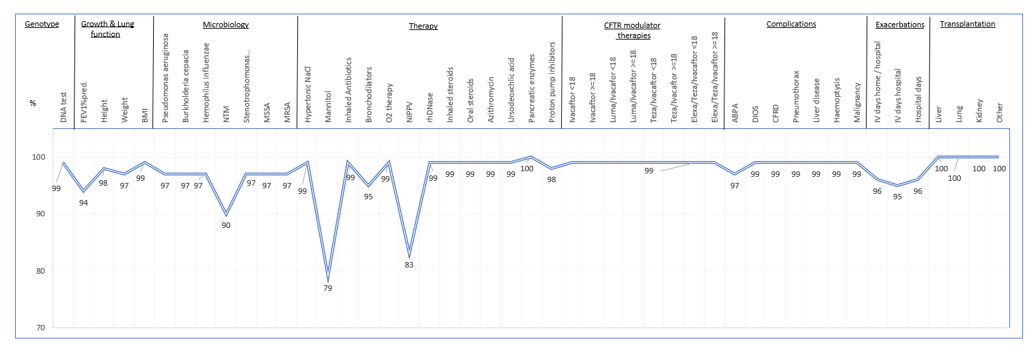
Figure 12.1
Data completeness in the follow-up year 2022 for all non-transplanted people with CF seen in all participating countries, as overall percentages by variable.
Note: Completeness for FEV1 is evaluated only on people of at least 6 years old.
Note: Completeness for BMI is evaluated for people of at least 2 years old.
ECFSPR Annual Report 2022, Zolin A, Adamoli A, Bakkeheim E, van Rens J et al, 2024

Slide 93
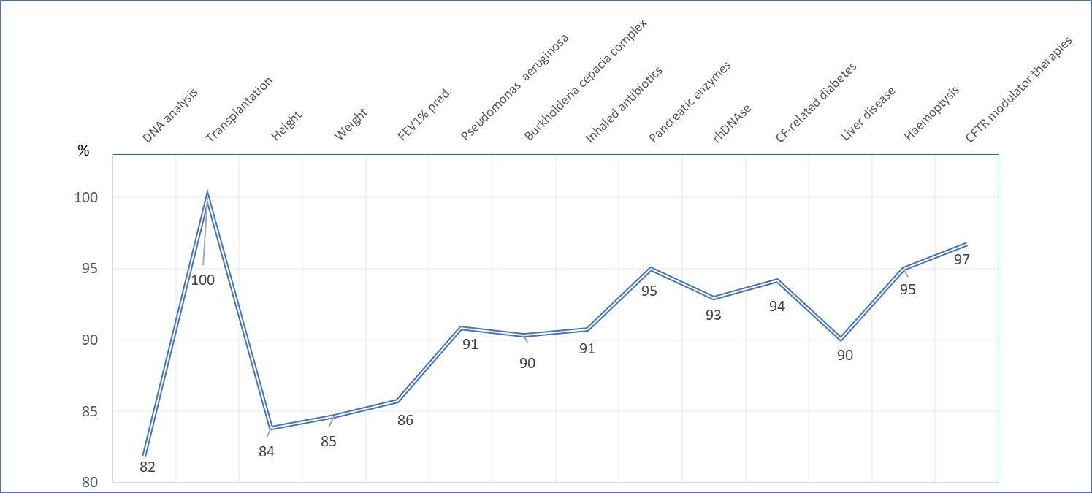
Figure 12.2
Data accuracy for the follow-up years 2021 and 2022 from countries visited, overall results by variable
ECFSPR Annual Report 2022, Zolin A, Adamoli A, Bakkeheim E, van Rens J et al, 2024

