Slide 1

ECFSPR 2021 ANNUAL DATA REPORT
GRAPHS 2021
Citation:
ECFSPR Annual Report 2021, Zolin A, Orenti A, Jung A, van Rens J et al, 2023
If you use the graph(s) to include in your presentation:
Include the citation as above.
Consider the note(s) below the graph to better understand the graph.
For information contact ecfs-pr@uzleuven.be.
www.ecfs.eu/pr

Slide 2
CHAPTER 1: DEMOGRAPHICS
1.1 Map of countries
1.2 Number of people with CF
1.3 Age at follow-up distribution
1.4 Distribution by sex
1.5 Proportion of children and adults
1.6 Age at follow-up by country and overall
1.7 Sex distribution by country and overall
CHAPTER 2: DIAGNOSIS
2.1 Age at diagnosis, <18 years
2.2 Age at diagnosis, adults
2.3 Children diagnosed <3 months or 3 months – 18 years
2.4 Adults diagnosed <3months or 3 months – 18 years
2.5 Proportion of children, underwent neonatal screening
2.6 People with CF with meconium, ileus
CHAPTER 3: GENETICS
3.1 Proportion of identified variants
3.2 Prevalence of F508del homozygous and heterozygous
3.3 Map distribution of F508del variant
3.4 Map distribution of G542X variant
3.5 Map distribution of N130K variant
3.6 Map distribution of G551D variant
3.7 Map distribution of 2789+5G>A variant
CHAPTER 4: LUNG FUNCTION
4.1 FEV1% predicted, by country and overall
4.2 FEV1% predicted, descriptive statistics, by country
4.3 Median FEV1% by age group and by country
4.4 Quartiles of FEV1% by age group and by country, 6 years or older
4.5 FEV1% 6-17 years by country
4.6 FEV1% 18-29 years by country
4.7 FEV1% 30 years or older by country
CHAPTER 5: MICROBIOLOGY
5.1 Prevalence of Chronic Pseudomonas aseruginosa
5.2 Prevalence of Burkholderia cepacia complex specie
5.3 Prevalence of Haemophilus influenzae
5.4 Prevalence of Staphylococcus aureus
5.5 Prevalence of MRSA
5.6 Prevalence of Stenotrophomonas maltophilia
5.7 Prevalence of Achromobacter species infection
CHAPTER 6: NUTRITION
6.1 Use of pancreatic enzymes
6.2 Median z-score for BMI 2 – 17 years by country
6.3 Quartiles of z-scores for BMI 2 – 17 years by country
6.4 Proportion of 2 – 17 years who are underweight
6.5 Proportion of adults with BMI<20 by sex and by country
CHAPTER 7: RESPIRATORY COMPLICATIONS AND THERAPIES
7.1 Prevalence of allergic bronchopulmonary aspergillosis
7.2 Use of inhaled hypertonic saline
7.3 Use of rhDNase
7.4 Use of inhaled antibiotics
7.5 Use of bronchodilators
7.6 Use of macrolides
7.7 Use of oxygen
7.8 Use of inhaled steroids
7.9 Use of oral steroids
CHAPTER 8: GASTRO-INTESTINAL COMPLICATIONS AND THERAPIES
8.1 Prevalence of CFRD, adults
8.2 Prevalence and severity of liver disease
8.3 Use of ursodeoxycholic acid
8.4 Use of proton pump inhibitors (PPI)
CHAPTER 9: CFTR MODULATOR THERAPIES
9.1 Map Ivacaftor reimbursed
9.2 Map lumacaftor/ivacaftor reimbursed
9.3 Map tezacaftor/ivacaftor reimbursed
9.4 Map elexacaftor/tezacaftor/ivacaftor is licensed and reimbursed
9.5 People with CF eligible for at least one modulator, children
9.6 People with CF eligible for at least one modulator, adults
CHAPTER 10: TRANSPLANTATION
10.1 People with CF living in 2021 with transplanted lungs
10.2 people with CF living in 2020 with transplanted liver
CHAPTER 11: MORTALITY
11.1 Age at death distribution of people with CF deceased in 2021
CHAPTER 12: LONGITUDINAL DATA
12.1 People with CF and number of countries from 2008 to 2021
12.2 People with CF and percentage of adults and children from 2008 to 2021
12.3 Neonatal screening done in people with CF 5 years old or younger in the year of follow-up from 2011 to 2021
12.4 Median FEV1% by age group in 2011, 2016 and 2021
12.5 Prevalence of people with CF infected by Pseudomonas aeruginosa by age group in 2011, 2016 and 2021
12.6 Median z-score for BMI by age group in 2011, 2016 and 2021
12.7 Median z-score for BMI by age group in 2011, 2016 and 2021
12.8 Use of therapies among adults from 2011 to 2021
12.9 Use of therapies among adults from 2011 to 2021
www.ecfs.eu/pr

Slide 3
CHAPTER 1
DEMOGRAPHICSS
www.ecfs.eu/pr

Slide 4

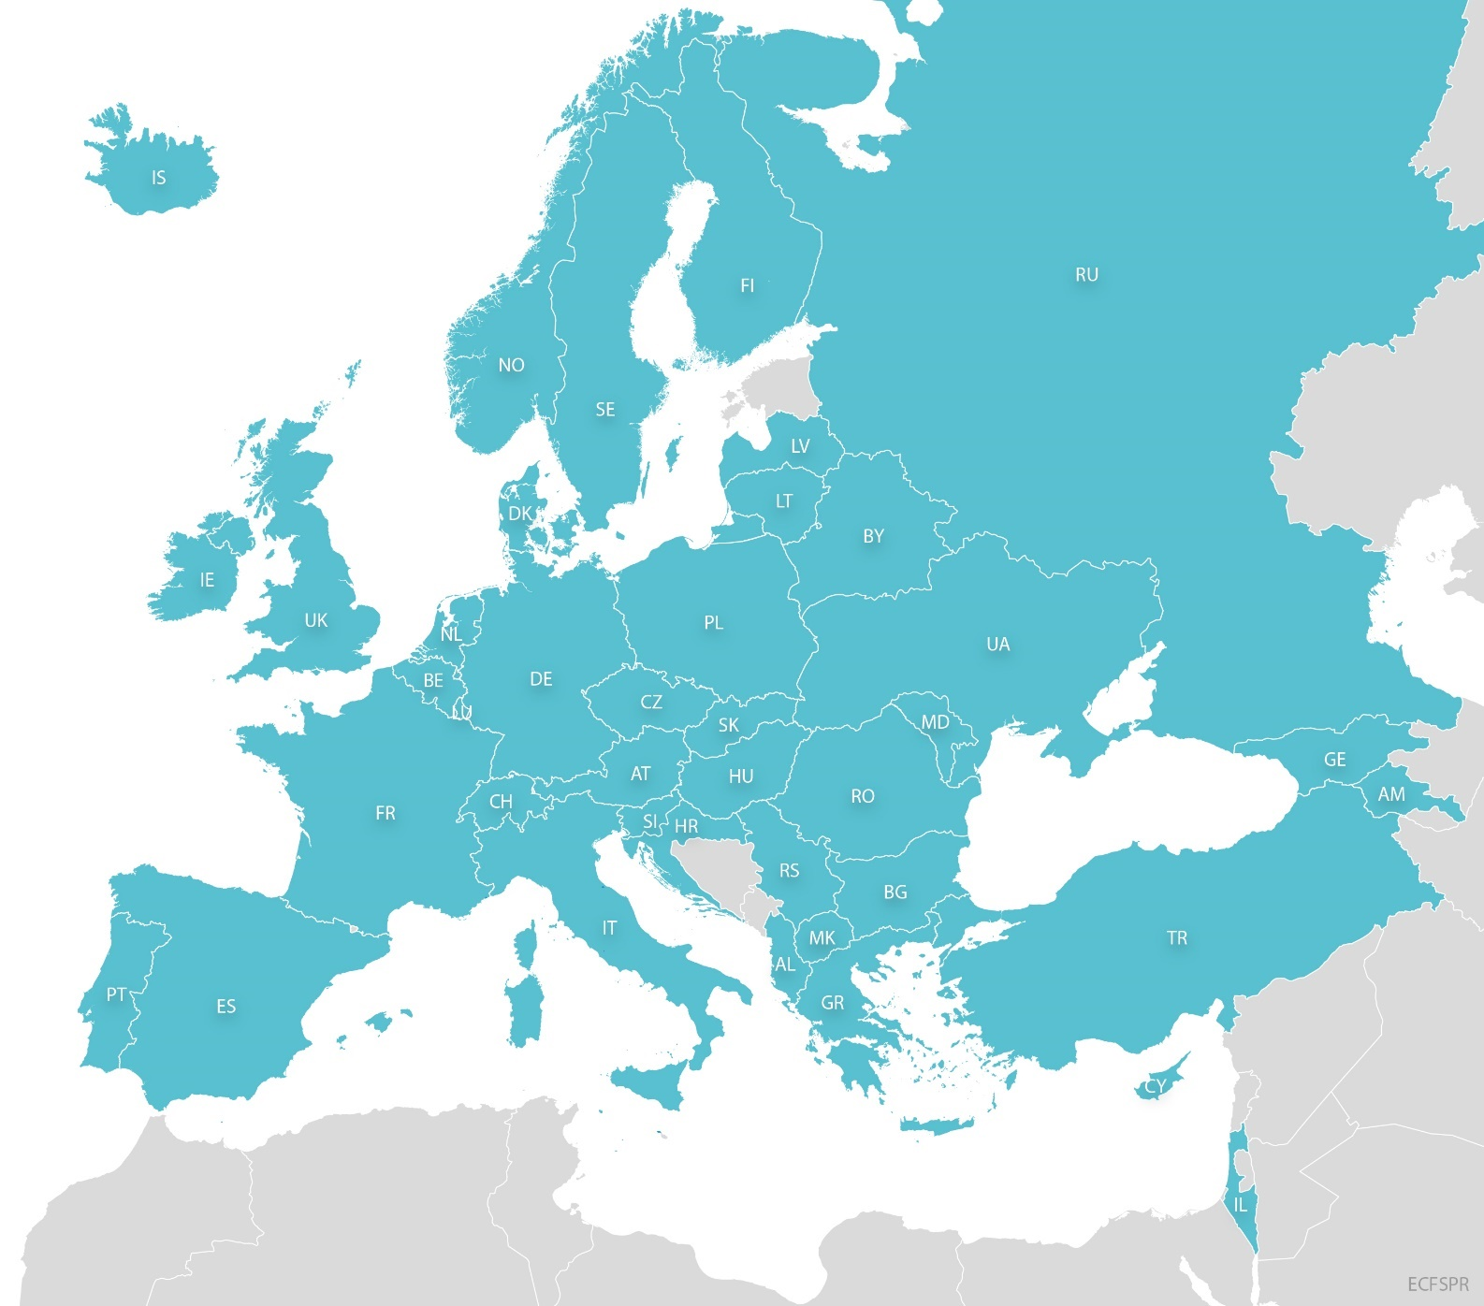
Figure 1.1
Map of countries that contributed data to the ECFSPR for the year 2021.
Marked in turquoise are the countries that contributed 2021 data.
Note: Armenia, Lithuania, Luxembourg, Romania, Turkey and Ukraine have a coverage of less than 80%.
ECFSPR Annual Report 2021, Zolin A, Orenti A, Jung A, van Rens J et al, 2023

Slide 5
Figure 1.2
The number of people with CF registered in the ECFSPR varies across countries and continues to grow.
Number of people with CF registered in the ECFSR in 2021.
Note: United Kingdom: In the graphs of this report, we use GB as abbreviation for the United Kingdom of United Kingdom and Northern Ireland.
ECFSPR Annual Report 2021, Zolin A, Orenti A, Jung A, van Rens J et al, 2023

Slide 6
Figure 1.3
Age distribution demonstrates a sharp decline from the third decade of life.
Age at follow-up distribution. People with CF alive on 31/12/2021.
ECFSPR Annual Report 2021, Zolin A, Orenti A, Jung A, van Rens J et al, 2023

Slide 7
Figure 1.4
Age distribution is remarkably skewed towards childhood and adolescence in CF.
Distribution of age at follow up by sex.
ECFSPR Annual Report 2021, Zolin A, Orenti A, Jung A, van Rens J et al, 2023

Slide 8
Figure 1.5
The proportion of adults with CF varies considerably between European countries.
Proportion of children and adults, by country and overall. People with CF alive on 31/12/2021.
Note: Luxembourg: An adult centre didn’t provide data for year 2021
Note: United Kingdom: In the graphs of this report, we use GB as abbreviation for the United Kingdom of United Kingdom and Northern Ireland.
ECFSPR Annual Report 2021, Zolin A, Orenti A, Jung A, van Rens J et al, 2023

Slide 9
Figure 1.6
The mean age of the CF population is not homogenous in Europe and depends on the country or region of residence.
Age at follow-up: box-plot, by country and overall. People with CF alive on 31/12/2021.
Note: Luxembourg: An adult centre didn’t provide data for year 2021.
Note: United Kingdom: In the graphs of this report, we use GB as abbreviation for the United Kingdom of United Kingdom and Northern Ireland.
ECFSPR Annual Report 2021, Zolin A, Orenti A, Jung A, van Rens J et al, 2023

Slide 10
Figure 1.7
Sex distribution is comparatively homogenous throughout Europe except for a few countries.
Sex distribution, by country and overall. People with CF alive on 31/12/2021.
Note: United Kingdom: In the graphs of this report, we use GB as abbreviation for the United Kingdom of United Kingdom and Northern Ireland
ECFSPR Annual Report 2021, Zolin A, Orenti A, Jung A, van Rens J et al, 2023

Slide 11
CHAPTER 2
DIAGNOSIS
www.ecfs.eu/pr

Slide 12
Figure 2.1
Age at diagnosis in children and adolescents depends on various factors, including availability of a newborn screening programme.
Age at diagnosis (in years): boxplot, by country and overall. All children and adolescents (<18 yrs) seen in 2021.
Note: For Cyprus, Greece and the Slovak Republic the information on age at diagnosis is missing for more than 10% of the children.
Note: United Kingdom: In the graphs of this report, we use GB as abbreviation for the United Kingdom of United Kingdom and Northern Ireland.
ECFSPR Annual Report 2021, Zolin A, Orenti A, Jung A, van Rens J et al, 2023

Slide 13
Figure 2.2
For adults, the age at diagnosis reflects national differences in the diagnostic approach over the last decades.
Age at diagnosis (in years): boxplot, by country and overall. All adults seen in 2021.
Note: Albania, Armenia, Belarus and Luxembourg have <5 adults seen in 2021 and are excluded from the figure, but the people are included in the total number.
Note: For Austria, Georgia, Greece, Hungary, The Netherlands, and Switzerland the information on age at diagnosis is missing for more than 10% of the people with CF.
Note: United Kingdom: In the graphs of this report, we use GB as abbreviation for the United Kingdom of United Kingdom and Northern Ireland.
ECFSPR Annual Report 2021, Zolin A, Orenti A, Jung A, van Rens J et al, 2023

Slide 14
Figure 2.3
With the implementation of newborn screening programmes, age at diagnosis has shifted to the first 3 months of life in many countries.
Proportion of children with CF diagnosed at younger than 3 months, between 3 months and 18 years, and older than 18 years, by country and overall. All children with CF seen in 2021.
Note: For Cyprus, Greece, and Slovak Republic the information on age at diagnosis is missing for more than 10% of the children.
Note: United Kingdom: In the graphs of this report, we use GB as abbreviation for the United Kingdom of United Kingdom and Northern Ireland.
ECFSPR Annual Report 2021, Zolin A, Orenti A, Jung A, van Rens J et al, 2023

Slide 15
Figure 2.4
With the implementation of newborn screening programmes, age at diagnosis has shifted to the first 3 months of life in many countries.
Proportion of adults with CF diagnosed at younger than 3 months, between 3 months and 18 years, and older than 18 years, by country and overall. All adults with CF seen in 2021.
Note: Albania, Armenia, Belarus and Luxembourg have <5 adults seen in 2021 and are excluded from the figure, but the people are included in the total number.
Note: For Austria, Georgia, Greece, Hungary, The Netherlands, and Switzerland the information on age at diagnosis is missing for more than 10% of the people with CF.
Note: United Kingdom: In the graphs of this report, we use GB as abbreviation for the United Kingdom of United Kingdom and Northern Ireland.
ECFSPR Annual Report 2021, Zolin A, Orenti A, Jung A, van Rens J et al, 2023

Slide 16
Figure 2.5
The proportion of young children with CF diagnosed through newborn screening has increased in many countries over the years
Proportion of children with CF who underwent neonatal screening, by country and overall. Children 5 years old or younger seen in 2021.
Note: Armenia, Cyprus and Iceland have <5 children 5 years old or younger seen in 2021 and are excluded from the graph.
Note: For Belgium and Israel the information on neonatal screening is missing for more than 10% of the children ≤5 years old.
Note: For France and the United Kingdom positive answers (“neonatal screening performed”) are reported only when neonatal screening is one of the factors that led to CF diagnosis.
Note: United Kingdom: In the graphs of this report, we use GB as abbreviation for the United Kingdom of United Kingdom and Northern Ireland.
ECFSPR Annual Report 2021, Zolin A, Orenti A, Jung A, van Rens J et al, 2023

Slide 17
Figure 2.6
Meconium ileus at birth is not rare and may be the first symptom of CF detected in newborns.
People with CF with meconium ileus, by country and overall. People with CF aged 10 years or younger.
Note: For Cyprus, Germany and Israel the information on meconium ileus is missing for more than 10% of the children ≤10 years old.
Note: United Kingdom: In the graphs of this report, we use GB as abbreviation for the United Kingdom of United Kingdom and Northern Ireland.
ECFSPR Annual Report 2021, Zolin A, Orenti A, Jung A, van Rens J et al, 2023

Slide 18
CHAPTER 3
GENETICS
www.ecfs.eu/pr

Slide 19
Figure 3.1
Most of the people with CF in Europe have two identified CFTR variants.
Proportion of identified variants, by country and overall. Only people with CF with DNA analysis
Note: United Kingdom: In the graphs of this report, we use GB as abbreviation for the United Kingdom of United Kingdom and Northern Ireland.
ECFSPR Annual Report 2021, Zolin A, Orenti A, Jung A, van Rens J et al, 2023

Slide 20
Figure 3.2
The prevalence of the F508del variant varies considerably between the countries in Europe, which has major impact on CFTR modulator eligibility
Prevalence of F508del homozygous and heterozygous people with CF, by country and overall. All people with CF seen in 2021.
Note: United Kingdom: In the graphs of this report, we use GB as abbreviation for the United Kingdom of United Kingdom and Northern Ireland.
ECFSPR Annual Report 2021, Zolin A, Orenti A, Jung A, van Rens J et al, 2023

Slide 21
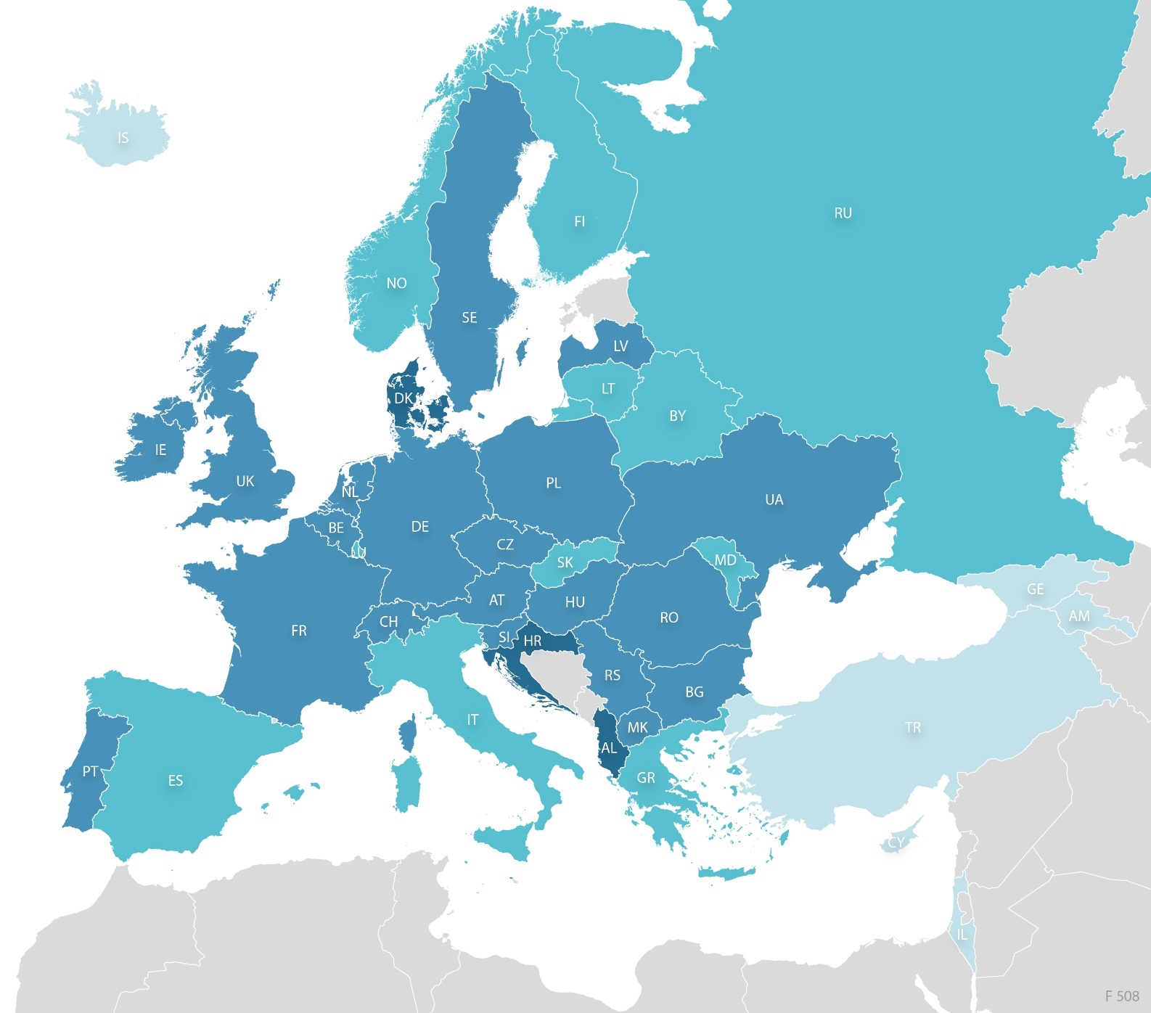
Figure 3.3
Geographical distribution of F508del variant.
ECFSPR Annual Report 2021, Zolin A, Orenti A, Jung A, van Rens J et al, 2023

Slide 22
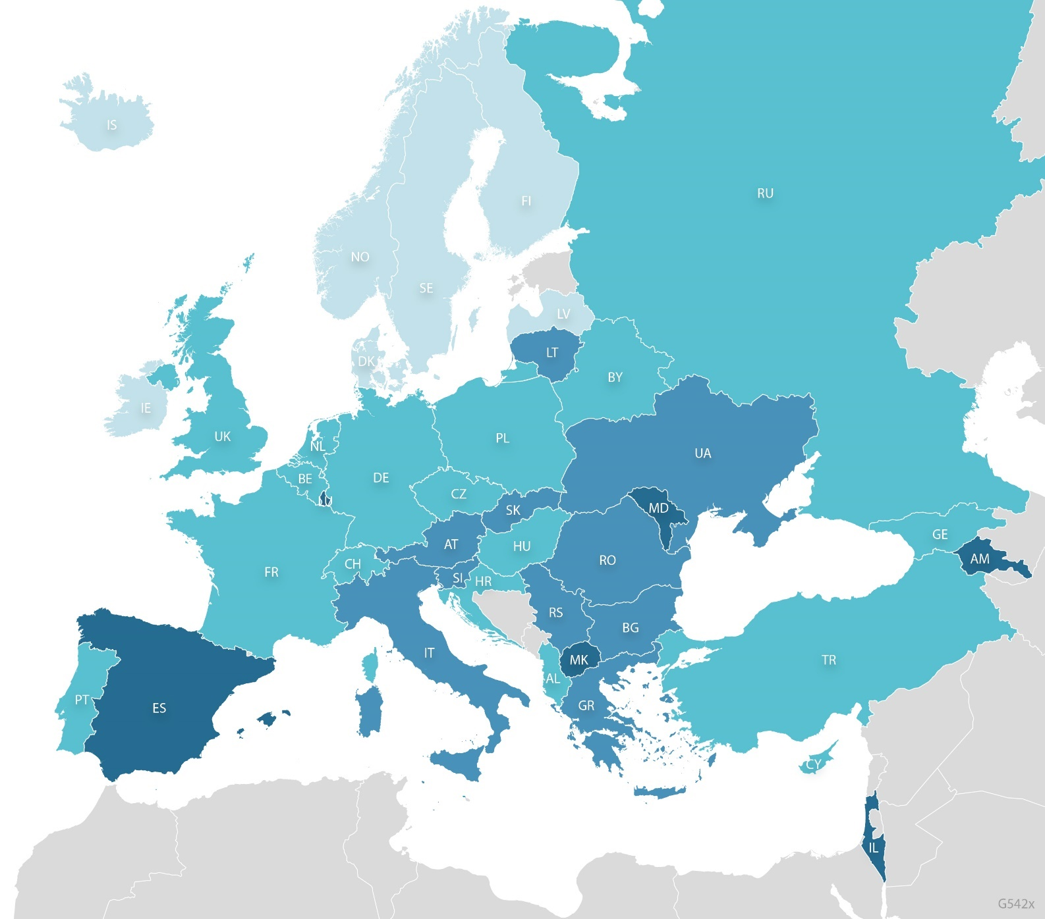
Figure 3.4
Geographical distribution of G542X variant.
ECFSPR Annual Report 2021, Zolin A, Orenti A, Jung A, van Rens J et al, 2023

Slide 23
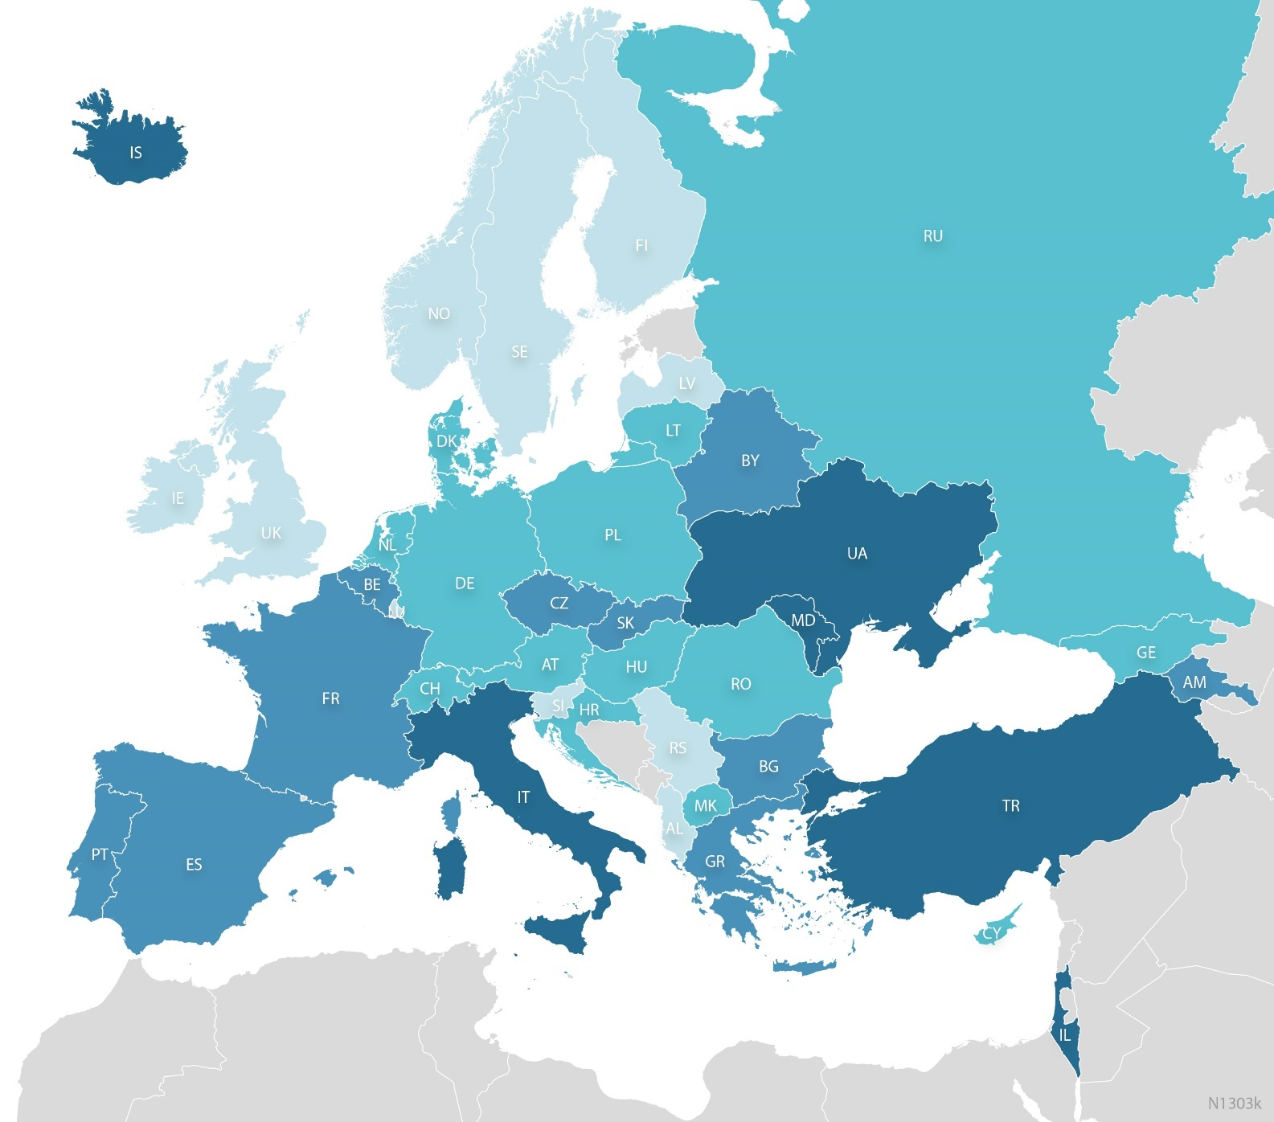
Figure 3.5
Geographical distribution of N1303K variant.
ECFSPR Annual Report 2021, Zolin A, Orenti A, Jung A, van Rens J et al, 2023

Slide 24
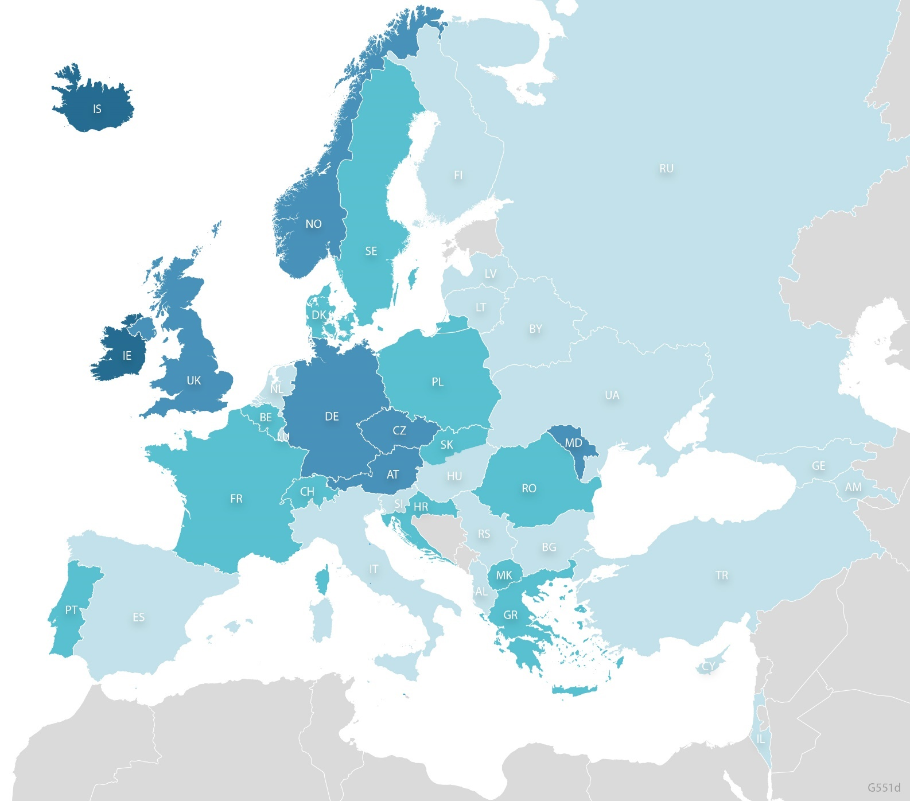
Figure 3.6
Geographical distribution of G551D variant.
ECFSPR Annual Report 2021, Zolin A, Orenti A, Jung A, van Rens J et al, 2023

Slide 25
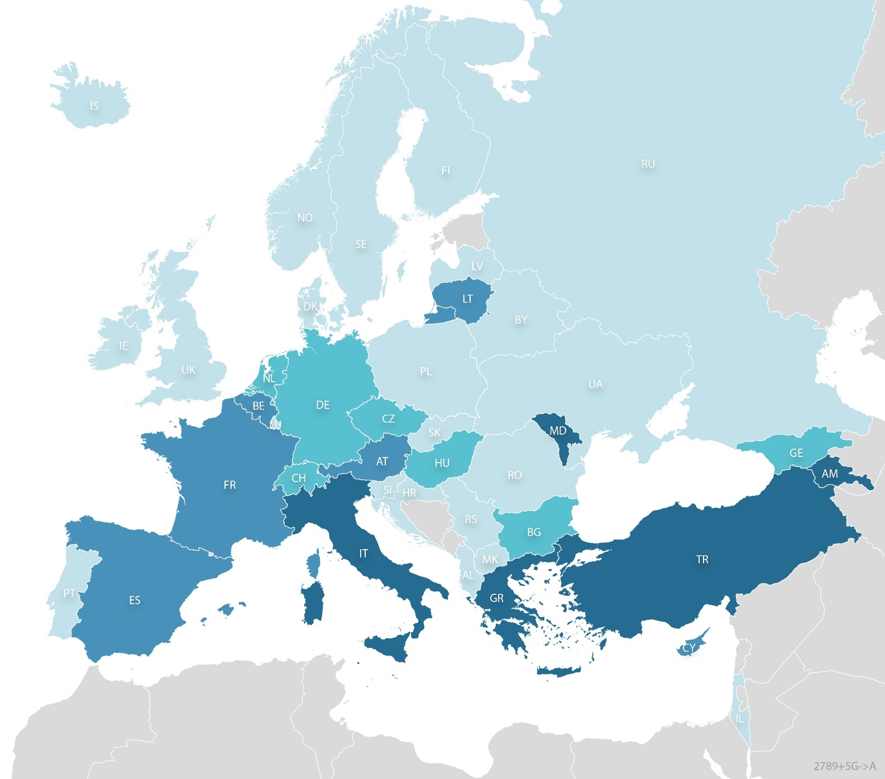
Figure 3.7
Geographical distribution of 2789+5G->A variant.
ECFSPR Annual Report 2021, Zolin A, Orenti A, Jung A, van Rens J et al, 2023

Slide 26
CHAPTER 4
LUNG FUNCTION
www.ecfs.eu/pr

Slide 27
Figure 4.1
Median FEV1 of young children and adolescents with CF <18 years of age is >80% in almost all countries in Europe.
FEV1% of predicted: boxplot by country. Children and adolescents with CF aged 6-17 years who have never had a transplant, seen in 2021.
Note: Georgia has <5 individuals aged 6-17 years at the date of FEV1 measurement and is excluded from the graph.
Note: The United Kingdom reports FEV1 from the annual review, which might not be the best FEV1 of the year, and, in some cases, the FEV1 measurement could be from the previous calendar year.
Note: United Kingdom: In the graphs of this report, we use GB as abbreviation for the United Kingdom of United Kingdom and Northern Ireland.
ECFSPR Annual Report 2021, Zolin A, Orenti A, Jung A, van Rens J et al, 2023

Slide 28
Figure 4.2
Median FEV1 of adults with CF varies between <60% and >90% depending on the country.
FEV1% of predicted: Adults with CF who have never had a transplant, seen in 2021.
Note: Albania, Armenia, Belarus, Georgia, Luxembourg, Rep of Moldova and Romania have <5 adults with FEV1 measurement and are excluded from the graph.
Note: The United Kingdom reports FEV1 from the annual review, which might no be the best FEV1 of the year, and, in some cases, the FEV1 measurement could be from the previous calendar year.
Note: United Kingdom: In the graphs of this report, we use GB as abbreviation for the United Kingdom of United Kingdom and Northern Ireland.
ECFSPR Annual Report 2021, Zolin A, Orenti A, Jung A, van Rens J et al, 2023

Slide 29
Figure 4.3
Lung function declines between the third and fifth decade of life but stabilises in older people with CF.
Median FEV1% of predicted by age group and by country.
This graph shows the median FEV₁% (the value that separates the highest and lowest half of the people with CF) by age group. Each country median is represented by a dot (in turquoise) and the overall median is in pink.
Note: We excluded from the graph those age groups where the number of individuals was <10.
ECFSPR Annual Report 2021, Zolin A, Orenti A, Jung A, van Rens J et al, 2023

Slide 30
Figure 4.4
Lung function decline over time in adults with CF still poses a challenge in Europe.
Quartiles of FEV1% of predicted by age group and by country. People with CF aged 6 years or older and who have never had a transplant.
ECFSPR Annual Report 2021, Zolin A, Orenti A, Jung A, van Rens J et al, 2023

Slide 31
Figure 4.4
Lung function decline over time in adults with CF still poses a challenge in Europe.
Quartiles of FEV1% of predicted by age group and by country. People with CF aged 6 years or older and who have never had a transplant.
ECFSPR Annual Report 2021, Zolin A, Orenti A, Jung A, van Rens J et al, 2023

Slide 32
Figure 4.4
Lung function decline over time in adults with CF still poses a challenge in Europe.
Quartiles of FEV1% of predicted by age group and by country. People with CF aged 6 years or older and who have never had a transplant.
ECFSPR Annual Report 2021, Zolin A, Orenti A, Jung A, van Rens J et al, 2023

Slide 33
Figure 4.4
Lung function decline over time in adults with CF still poses a challenge in Europe.
Quartiles of FEV1% of predicted by age group and by country. People with CF aged 6 years or older and who have never had a transplant.
ECFSPR Annual Report 2021, Zolin A, Orenti A, Jung A, van Rens J et al, 2023

Slide 34
Figure 4.4
Lung function decline over time in adults with CF still poses a challenge in Europe.
Quartiles of FEV1% of predicted by age group and by country. People with CF aged 6 years or older and who have never had a transplant.
Note: The United Kingdom reports FEV1 from the annual review, which might not be the best FEV1 of the year, and, in some cases, the FEV1 measurement could be from the previous calendar year.
ECFSPR Annual Report 2021, Zolin A, Orenti A, Jung A, van Rens J et al, 2023

Slide 35
Figure 4.5
The majority of all children and adolescents with CF in Europe have a FEV1 of over 80% predicted.
FEV1% of predicted according to severity group and age group, by country. Children and adolescents with CF aged 6 – 17 years who have never had a transplant.
Note: Georgia has <5 people with CF aged 6-17 years at FEV1 measurement and is excluded from the graph.
Note: The United Kingdom reports FEV1 from the annual review, which might no be the best FEV1 of the year, and, in some cases, the FEV1 measurement could be from the previous calendar year.
Note: United Kingdom: In the graphs of this report, we use GB as abbreviation for the United Kingdom of United Kingdom and Northern Ireland.
ECFSPR Annual Report 2021, Zolin A, Orenti A, Jung A, van Rens J et al, 2023

Slide 36
Figure 4.6
In the majority of countries, the proportion of young adults with CF with a FEV1 below 40% predicted is less than 10-20%.
FEV1% of predicted according to severity group and age group, by country. Adults with CF aged 18 – 29 years who have never had a transplant.
Note: Albania, Armenia, Belarus, Georgia, Iceland, Luxembourg, Rep of Moldova, and Romania have <5 people aged 18-29 years with FEV1 measurement and
are excluded from the graph.
Note: The United Kingdom reports FEV1 from the annual review, which might not be the best FEV1 of the year, and, in some cases, the FEV1 measurement could be from the previous calendar year.
Note: United Kingdom: In the graphs of this report, we use GB as abbreviation for the United Kingdom of United Kingdom and Northern Ireland.
ECFSPR Annual Report 2021, Zolin A, Orenti A, Jung A, van Rens J et al, 2023

Slide 37
Figure 4.7
In the majority of countries, most adults with CF aged 30 years or older have a FEV1 between 40% and 80%.
FEV1% of predicted according to severity group and age group, by country and overall. Adults with CF aged 30 years or older who have never had a transplant.
Note: Albania, Armenia, Belarus, Cyprus, Georgia, Iceland, Latvia, Luxembourg, Rep of Moldova, and Romania have <5 people aged 30 years or more with FEV1 measurement and are excluded from the graph.
Note: The United Kingdom reports FEV1 from the annual review, which might not be the best FEV1 of the year, and, in some cases, the FEV1 measurement could be from the previous calendar year.
Note: United Kingdom: In the graphs of this report, we use GB as abbreviation for the United Kingdom of United Kingdom and Northern Ireland.
ECFSPR Annual Report 2021, Zolin A, Orenti A, Jung A, van Rens J et al, 2023

Slide 38
CHAPTER 5
MICROBIOLOGY
www.ecfs.eu/pr

Slide 39
Figure 5.1
Pseudomonas aeruginosa, together with Staphylococcus aureus and Haemophilus influenzae, is the predominant respiratory pathogen in people with CF, though prevalence varies between age and countries
Prevalence of Chronic Pseudomonas aeruginosa in people with CF seen in 2021 who have never had a transplant, by country.
Note: We excluded from the graph the countries for which the information is missing for more than 10% of the children/adults. Albania, Armenia, Belarus and Luxembourg have <5 adults seen in 2021 and are excluded from the graph for adults.
Note: Ireland and Italy: chronicity for Pseudomonas aeruginosa is defined as: at least 3 or more positive isolates during the last 12 months preceding the last reported culture in 2021.
Note: The United Kingdom: chronicity for Pseudomonas aeruginosa is defined as: 3 or more positive isolates during the 12 months preceding the last annual review.
Note: United Kingdom: In the graphs of this report, we use GB as abbreviation for the United Kingdom of United Kingdom and Northern Ireland.
ECFSPR Annual Report 2021, Zolin A, Orenti A, Jung A, van Rens J et al, 2023

Slide 40
Figure 5.2
In some countries, Burkholderia cepacia complex spp. belong to the emerging respiratory pathogens with increasing prevalence
Prevalence of Burkholderia cepacia complex species in people with CF seen in 2021 who have never had a transplant, by country.
Note: We excluded from the graph the countries for which the information is missing for more than 10% of the children/adults. Albania, Armenia, Belarus and Luxembourg have <5 adults seen in 2021 and are excluded from the graph for adults.
Note: Ireland and Italy: chronicity for Burkholderia cepacia complex is defined as: at least 3 or more positive isolates during the last 12 months preceding the last reported culture in 2021.
Note: The United Kingdom: chronicity for Burkholderia cepacia complex is not collected.
Note: United Kingdom: In the graphs of this report, we use GB as abbreviation for the United Kingdom of United Kingdom and Northern Ireland.
ECFSPR Annual Report 2021, Zolin A, Orenti A, Jung A, van Rens J et al, 2023

Slide 41
Figure 5.3
Haemophilus influenzae, together with Pseudomonas aeruginosa and Staphylococcus aureus, is the predominant respiratory pathogen in people with CF, though prevalence varies between age and countries.
Prevalence of Haemophilus influenzae in people with CF seen in 2021 who have never had a transplant, by country.
Note: We excluded from the graph the countries for which the information is missing for more than 10% of the children/adults. Albania, Armenia, Belarus and Luxembourg have <5 adults seen in 2021 and are excluded from the graph for adults.
Note: Belgium, France, Germany and United Kingdom: chronicity for Haemophilus influenza is not collected. Ireland and Italy: chronicity for Haemophilus influenzae is defined as: at least 3 or more positive isolates during the last 12 months preceding the last reported culture in 2021.
Note: United Kingdom: In the graphs of this report, we use GB as abbreviation for the United Kingdom of United Kingdom and Northern Ireland.
ECFSPR Annual Report 2021, Zolin A, Orenti A, Jung A, van Rens J et al, 2023

Slide 42
Figure 5.4
Haemophilus influenzae, together with Pseudomonas aeruginosa and Staphylococcus influenzae, is the predominant respiratory pathogen in people with CF, though prevalence varies between age and countries.
Prevalence of Staphylococcus aureus in people with CF seen in 2021 who have never had a transplant, by country.
Note: We excluded from the graph the countries for which the information is missing for more than 10% of the children/adults. Albania, Armenia, Belarus and Luxembourg have <5 adults seen in 2021 and are excluded from the graph for adults.
Note: Belgium: chronic Staphylococcus Aureus: Variable is not collected as such, but chronicity is derived comparing the information of the current year and the year before.
Ireland and Italy: chronicity for Staphylococcus Aureus is defined as: at least 3 or more positive isolates during the last 12 months preceding the last reported culture in 2021. The United Kingdom: chronicity for Staphylococcus Aureus is defined as: 3 or more positive isolates during the 12 months preceding the last annual review.
Note: United Kingdom: In the graphs of this report, we use GB as abbreviation for the United Kingdom of United Kingdom and Northern Ireland.
ECFSPR Annual Report 2021, Zolin A, Orenti A, Jung A, van Rens J et al, 2023

Slide 43
Figure 5.5
Prevalence of methicillin-resistant Staphylococcus aureus (MRSA) in the airways is very heterogeneous in people with CF throughout Europe.
Prevalence of methicillin-resistant Staphylococcus aureus (MRSA) in people with CF seen in 2021 who have never had a transplant, by country.
Note: We excluded from the graph the countries for which the information is missing for more than 10% of the children/adults. Albania, Armenia, Belarus and Luxembourg have <5 adults seen in 2021 and are excluded from the graph for adults.
Note: Ireland and Italy: chronicity for methicillin-resistant Staphylococcus Aureus is defined as: at least 3 or more positive isolates during the last 12 months preceding the last reported culture in 2021. The United Kingdom: chronicity for methicillin-resistant Staphylococcus Aureus is not collected.
Note: United Kingdom: In the graphs of this report, we use GB as abbreviation for the United Kingdom of United Kingdom and Northern Ireland.
ECFSPR Annual Report 2021, Zolin A, Orenti A, Jung A, van Rens J et al, 2023

Slide 44
Figure 5.6
In the majority of countries, Stenotrophomonas Maltophilia can be cultured in a significant number of airway samples in children and adults with CF.
Prevalence of Stenotrophomonas maltophilia in people with CF seen in 2021 who have never had a transplant, by country.
Note: We excluded from the graph the countries for which the information is missing for more than 10% of the children/adults. Albania, Armenia, Belarus and Luxembourg have <5 adults seen in 2021 and are excluded from the graph for adults.
Note: Ireland and Italy: chronicity for Stenotrophomonas maltophilia is defined as: at least 3 or more positive isolates during the last 12 months preceding the last reported culture in 2021. The United Kingdom: chronicity for Stenotrophomonas maltophilia is not collected.
Note: United Kingdom: In the graphs of this report, we use GB as abbreviation for the United Kingdom of United Kingdom and Northern Ireland.
ECFSPR Annual Report 2021, Zolin A, Orenti A, Jung A, van Rens J et al, 2023

Slide 45
Figure 5.7
Achromobacter spp. can be found in up to 20% of the airways of people with CF, with a higher prevalence in adults.
Prevalence of Achromobacter species infection in people with CF seen in 2021 who have never had a transplant, by country.
Note: We excluded from the graph the countries for which the information is missing for more than 10% of the children/adults. Albania, Armenia, Belarus and Luxembourg have <5 adults seen in 2021 and are excluded from the graph for adults.
Note: France: chronicity for Achromobacter species is not collected.Ireland and Italy: chronicity for Achromobacter species is defined as: at least 3 or more positive isolates during the last 12 months preceding the last reported culture in 2021. The United Kingdom: chronicity for Achromobacter species is not collected.
Note: United Kingdom: In the graphs of this report, we use GB as abbreviation for the United Kingdom of United Kingdom and Northern Ireland.
ECFSPR Annual Report 2021, Zolin A, Orenti A, Jung A, van Rens J et al, 2023

Slide 46
CHAPTER 6
NUTRITION
www.ecfs.eu/pr

Slide 47
Figure 6.1
In the majority of countries, more than 80% of the people with CF are pancreatic insufficient.
Use of pancreatic enzymes in 2021 for all people with CF who have never had a transplant, by country.
Note: United Kingdom: In the graphs of this report, we use GB as abbreviation for the United Kingdom of United Kingdom and Northern Ireland.
ECFSPR Annual Report 2021, Zolin A, Orenti A, Jung A, van Rens J et al, 2023

Slide 48
Figure 6.2
While the median BMI z-score for children and adolescents with CF in Europe is close to normal for all age groups, a lot of variation amongst the countries can be observed.
Median z-score for BMI by age group and by country. Children and adolescents with CF aged 2-17 years in 2021 who have never had a transplant.
This graph shows the median z-score for BMI (the value that separates the highest and lowest half of the people with CF) by age group. Each country median is represented by a turquoise dot and the median overall for the age group by a pink dot. There is a lot of variation between countries.
Note: We excluded from the graph those age groups where the number of individuals was <10.
ECFSPR Annual Report 2021, Zolin A, Orenti A, Jung A, van Rens J et al, 2023

Slide 49
Figure 6.3
The median BMI of children and adolescents with CF is influenced by age and country of residence.
Quartiles of z-scores for BMI by age group and country. Children and adolescents with CF aged 2-17 years in 2021 who have never had a transplant.
ECFSPR Annual Report 2021, Zolin A, Orenti A, Jung A, van Rens J et al, 2023

Slide 50
Figure 6.3
The median BMI of children and adolescents with CF is influenced by age and country of residence.
Quartiles of z-scores for BMI by age group and country. Children and adolescents with CF aged 2-17 years in 2021 who have never had a transplant.
ECFSPR Annual Report 2021, Zolin A, Orenti A, Jung A, van Rens J et al, 2023

Slide 51
Figure 6.3
The median BMI of children and adolescents with CF is influenced by age and country of residence.
Quartiles of z-scores for BMI by age group and country. Children and adolescents with CF aged 2-17 years in 2021 who have never had a transplant.
ECFSPR Annual Report 2021, Zolin A, Orenti A, Jung A, van Rens J et al, 2023

Slide 52
Figure 6.3
The median BMI of children and adolescents with CF is influenced by age and country of residence.
Quartiles of z-scores for BMI by age group and country. Children and adolescents with CF aged 2-17 years in 2021 who have never had a transplant.
ECFSPR Annual Report 2021, Zolin A, Orenti A, Jung A, van Rens J et al, 2023

Slide 53
Figure 6.4
Being underweight is a hallmark clinical feature in children and adolescents with CF. There are considerable differences amongst the countries.
Proportion of children and adolescents with CF who are underweight (z-score of BMI <-2) by sex and by country; aged 2-17 years in 2021 who have never had a transplant.
Note: We excluded from the graph the countries for which the information on underweight children and young people is missing for more than 10% of the individuals. Cyprus and Iceland been excluded from this graph because the number of children in one of the sex groups is less than 5.
Note: United Kingdom: In the graphs of this report, we use GB as abbreviation for the United Kingdom of United Kingdom and Northern Ireland.
ECFSPR Annual Report 2021, Zolin A, Orenti A, Jung A, van Rens J et al, 2023

Slide 54
Figure 6.5
Being underweight is a hallmark clinical feature in adults with CF. There are considerable differences amongst the countries.
Proportion of adults with BMI<20 by sex and by country; aged 18 years or older in 2021 who never had a transplant.
Note: We excluded from the graph the countries for which the information on underweight adults is missing for more than 10% of the individuals. Albania, Armenia, Cyprus, Iceland, Luxembourg, Republic of Moldova and Romania been excluded from this graph because the number of adults in one of the sex groups is less than 5.
Note: United Kingdom: In the graphs of this report, we use GB as abbreviation for the United Kingdom of United Kingdom and Northern Ireland.
ECFSPR Annual Report 2021, Zolin A, Orenti A, Jung A, van Rens J et al, 2023

Slide 55
CHAPTER 7
RESPIRATORY COMPLICATIONS AND THERAPIES
www.ecfs.eu/pr

Slide 56
Figure 7.1
ABPA is prevalent in 2-10% of children and adults with CF across Europe.
Prevalence of allergic bronchopulmonary aspergillosis in children and adults seen in 2021 who have never had a transplant, by country.
Note: We excluded from the graph the countries for which the information on allergic bronchopulmonary aspergillosis (ABPA) is missing for more than 10% of the people with CF.
Albania, Armenia, Belarus, and Luxembourg have <5 adults seen in 2021 and are excluded from the graph for adults.
Note: United Kingdom: In the graphs of this report, we use GB as abbreviation for the United Kingdom of United Kingdom and Northern Ireland.
ECFSPR Annual Report 2021, Zolin A, Orenti A, Jung A, van Rens J et al, 2023

Slide 57
Figure 7.2
Variation in the use of inhaled hypertonic saline indicates both inequalities and different therapeutic approaches.
Use of inhaled hypertonic saline in children and adults seen in 2021 who have never had a transplant, by country.
Note: We excluded from the graph the countries for which the information on inhaled hypertonic saline is missing for more than 10% of the people with CF. Albania, Armenia, Belarus and Luxembourg have <5 adults seen in 2021 and are excluded from the graph for adults.
Note: United Kingdom: the duration of use of inhaled hypertonic saline is not specified.
Note: Inhaled hypertonic saline is reimbursed in most countries except in Albania, Armenia, Bulgaria, Lithuania, the Republic of Moldova, Poland, Romania, the Russian Federation and Serbia. In Ukraine it is reimbursed for children, and in Turkey for children ≥ 6 years.
Note: United Kingdom: In the graphs of this report, we use GB as abbreviation for the United Kingdom of United Kingdom and Northern Ireland.
ECFSPR Annual Report 2021, Zolin A, Orenti A, Jung A, van Rens J et al, 2023

Slide 58
Figure 7.3
Variation in the use of rhDNAse indicates both inequalities in availability and different therapeutic approaches.
Use of rhDNase in children and adults seen in 2021 who have never had a transplant, by country.
Note: We excluded from the graph the countries for which the information on inhaled rhDNase is missing for more than 10% of the individuals. Albania, Armenia, Belarus, and Luxembourg have <5 adults seen in 2021 and are excluded from the graph for adults.
Note: Inhaled rhDNase is reimbursed in most countries except in Albania, Armenia and the Republic of Moldova. In Bulgaria, Georgia, Germany, Israel, Luxembourg, Macedonia, Norway, Romania, Spain, Ukraine and the United Kingdom it is reimbursed for individuals ≥ 5 years; in Latvia it is reimbursed for individuals ≥ 6 years.
Note: United Kingdom: In the graphs of this report, we use GB as abbreviation for the United Kingdom of United Kingdom and Northern Ireland.
ECFSPR Annual Report 2021, Zolin A, Orenti A, Jung A, van Rens J et al, 2023

Slide 59
Figure 7.4
Despite the increasing number of people with CF who have access to CFTR modulators, inhaled antibiotics are still an important therapeutic strategy in the prevention of pulmonary exacerbations, especially in adults with CF.
Use of inhaled antibiotics in children and adults seen in 2021 who have never had a transplant, by country.
Note: We excluded from the graph the countries for which the information on inhaled antibiotics is missing for more than 10% of the people with CF. Albania, Armenia, Belarus, and Luxembourg have <5 adults seen in 2021 and are excluded from the graph for adults.
Note: United Kingdom: the duration of use of inhaled antibiotics is not specified.
Note: Inhaled antibiotics are reimbursed in all countries. In Armenia only Gentamycin and in Romania only Tobi and Colobreath are reimbursed,.
Note: United Kingdom: In the graphs of this report, we use GB as abbreviation for the United Kingdom of United Kingdom and Northern Ireland.
ECFSPR Annual Report 2021, Zolin A, Orenti A, Jung A, van Rens J et al, 2023

Slide 60
Figure 7.5
Bronchodilators are used as widespread supportive treatment in many countries in Europe.
Use of bronchodilators in children and adults seen in 2021 who have never had a transplant, by country.
Note: We excluded from the graph the countries for which the information on the use of bronchodilators is missing for more than 10% of the people with CF. Albania, Armenia, Belarus, and Luxembourg have <5 adults seen in 2021 and are excluded from the graph for adults.
Note: United Kingdom: the duration of use of bronchodilators is not specified.
Note: Inhaled bronchodilators are reimbursed in most countries except in Bulgaria and Serbia. In Ukraine they are reimbursed for children.
Note: United Kingdom: In the graphs of this report, we use GB as abbreviation for the United Kingdom of United Kingdom and Northern Ireland.
ECFSPR Annual Report 2021, Zolin A, Orenti A, Jung A, van Rens J et al, 2023

Slide 61
Figure 7.6
Azithromycin, a surrogate marker of chronic Pseudomonas infection, is widely used throughout Europe, mostly by adults with CF.
Use of macrolides in children and adults seen in 2021 who have never had a transplant, by country.
Note: We excluded from the graph the countries for which the information on the use of macrolides is missing for more than 10% of the people. Albania, Armenia, Belarus, and Luxembourg have <5 adults seen in 2021 and are excluded from the graph for adults.
Note: Macrolides are reimbursed in most countries except in Bulgaria and Serbia. In the Republic of Moldova, they are reimbursed for children.
Note: United Kingdom: In the graphs of this report, we use GB as abbreviation for the United Kingdom of United Kingdom and Northern Ireland.
ECFSPR Annual Report 2021, Zolin A, Orenti A, Jung A, van Rens J et al, 2023

Slide 62
Figure 7.7
Oxygen treatment reflecting severe lung disease is prescribed in up to 15% of people with CF, mostly in the adult population.
Use of oxygen in children and adults seen in 2021 who have never had a transplant, by country.
Note: We excluded from the graph the countries for which the information on the use of oxygen is missing for more than 10% of the people.
Albania, Armenia, Belarus, and Luxembourg have <5 adults seen in 2021 and are excluded from the graph for adults.
Note: Oxygen therapy is reimbursed in most countries except in Bulgaria, the Republic of Moldova and Serbia. In Armenia and Georgia it is only reimbursed if the individual is hospitalised.
Note: United Kingdom: In the graphs of this report, we use GB as abbreviation for the United Kingdom of United Kingdom and Northern Ireland.
ECFSPR Annual Report 2021, Zolin A, Orenti A, Jung A, van Rens J et al, 2023

Slide 63
Figure 7.8
Pulmonary inflammation and exacerbation are often treated with inhaled or oral corticosteroids
Use of inhaled steroids in children and adults seen in 2021 who have never had a transplant, by country.
Note: We excluded from the graph the countries for which the information on use of inhaled steroids is missing for more than 10% of the people. Albania, Armenia, Belarus and Luxembourg have <5 adults seen in 2021 and are excluded from the graph for adults.
Note: Inhaled steroids are reimbursed in most countries except in Georgia, Lithuania and Serbia. In the Republic of Moldova, they are reimbursed for children. In Bulgaria they are reimbursed if people are also diagnosed with asthma or chronic obstructive pulmonary disease (COPD).
Note: United Kingdom: In the graphs of this report, we use GB as abbreviation for the United Kingdom of United Kingdom and Northern Ireland.
ECFSPR Annual Report 2021, Zolin A, Orenti A, Jung A, van Rens J et al, 2023

Slide 64
Figure 7.9
Pulmonary inflammation and exacerbation are often treated with oral or inhaled corticosteroids.
Use of oral steroids in children and adults seen in 2021 who have never had a transplant, by country.
Note: We excluded from the graph the countries for which the information on use of oral steroids is missing for more than 10% of the people. Albania, Armenia, Belarus, and Luxembourg have <5 adults seen in 2021 and are excluded from the graph for adults.
Note: Oral steroids are reimbursed in most countries except in Bulgaria, Lithuania, Republic of Moldova, Poland and Ukraine. In Latvia they are reimbursed for children.
Note: United Kingdom: In the graphs of this report, we use GB as abbreviation for the United Kingdom of United Kingdom and Northern Ireland.
ECFSPR Annual Report 2021, Zolin A, Orenti A, Jung A, van Rens J et al, 2023

Slide 65
CHAPTER 8
GASTRO-INTESTINAL COMPLICATIONS AND THERAPIES
www.ecfs.eu/pr

Slide 66
Figure 8.1
Important differences in the prevalence of CF-related diabetes throughout Europe might reflect genetic backgrounds , but also may be linked to life expectancy.
Prevalence of CFRD, by country. All adults with CF seen in 2021 aged 18 years or older who have never had a transplant.
Note: We excluded from the graph the countries for which the information on CFRD is missing for more than 10% of the adults. Albania, Armenia, Belarus, and Luxembourg have <5 adults seen in 2021 and are excluded from the graph for adults.
Note: United Kingdom: In the graphs of this report, we use GB as abbreviation for the United Kingdom of United Kingdom and Northern Ireland.
ECFSPR Annual Report 2021, Zolin A, Orenti A, Jung A, van Rens J et al, 2023

Slide 67
Figure 8.2
The prevalence of liver disease with or without cirrhosis is heterogenous across the countries in Europe.
Prevalence and severity of liver disease in children and adults seen in 2021 who have never had a transplant, by country.
Note: We excluded from the graph the countries for which the information on liver disease is missing for more than 10% of the people with CF. Albania, Armenia, Belarus and Luxembourg have <5 adults seen in 2021 and are excluded from the graph for adults.
Note: Belgium: collects only cirrhosis with portal hypertension “yes” or “no”, therefore no liver disease means no cirrhosis with portal hypertension.
Germany: variceal bleeding information not reported.
Serbia: cirrhosis without portal hypertension/hypersplenism means the presence of CF-related disease with normal liver function.
Ukraine: Liver disease without cirrhosis also includes ultrasound signs of changes in the liver.
Note: United Kingdom: In the graphs of this report, we use GB as abbreviation for the United Kingdom of United Kingdom and Northern Ireland.
ECFSPR Annual Report 2021, Zolin A, Orenti A, Jung A, van Rens J et al, 2023

Slide 68
Figure 8.3
Ursodeoxycholic acid is often prescribed for people with CF to treat cholestasis or liver disease.
Use of ursodeoxycholic acid in children and adults seen in 2021 who have never had a transplant, by country.
Note: We excluded from the graph the countries for which the information on oral ursodeoxycholic acid use is missing for more than 10% of the people with CF. Albania, Armenia, Belarus and Luxembourg have <5 adults seen in 2021 and are excluded from the graph for adults.
Note: Oral ursodeoxycholic acid is reimbursed in most countries in Europe, except in Armenia, Bulgaria, Lithuania, Serbia and Ukraine. In the Republic of Moldova, it is reimbursed for children and for 70% for adults.
Note: United Kingdom: In the graphs of this report, we use GB as abbreviation for the United Kingdom of United Kingdom and Northern Ireland.
ECFSPR Annual Report 2021, Zolin A, Orenti A, Jung A, van Rens J et al, 2023

Slide 69
Figure 8.4
Proton Pump Inhibitors are used to treat gastroesophageal reflux or gastritis, common complications in CF.
Use of proton pump inhibitors (PPI) in children and adults seen in 2021 who have never had a transplant, by country.
Note: We excluded from the graph the countries for which the information on the use of PPI is missing for more than 10% of the people with CF. Albania, Armenia, Belarus and Luxembourg have <5 adults seen in 2021 and are excluded from the graph for adults.
Note: Oral proton pump inhibitors are reimbursed in most countries except in Bulgaria, Lithuania, the Republic of Moldova, Serbia and Ukraine.
Note: United Kingdom: In the graphs of this report, we use GB as abbreviation for the United Kingdom of United Kingdom and Northern Ireland
ECFSPR Annual Report 2021, Zolin A, Orenti A, Jung A, van Rens J et al, 2023

Slide 70
CHAPTER 9
CFTR MODULATOR THERAPIES
www.ecfs.eu/pr

Slide 71
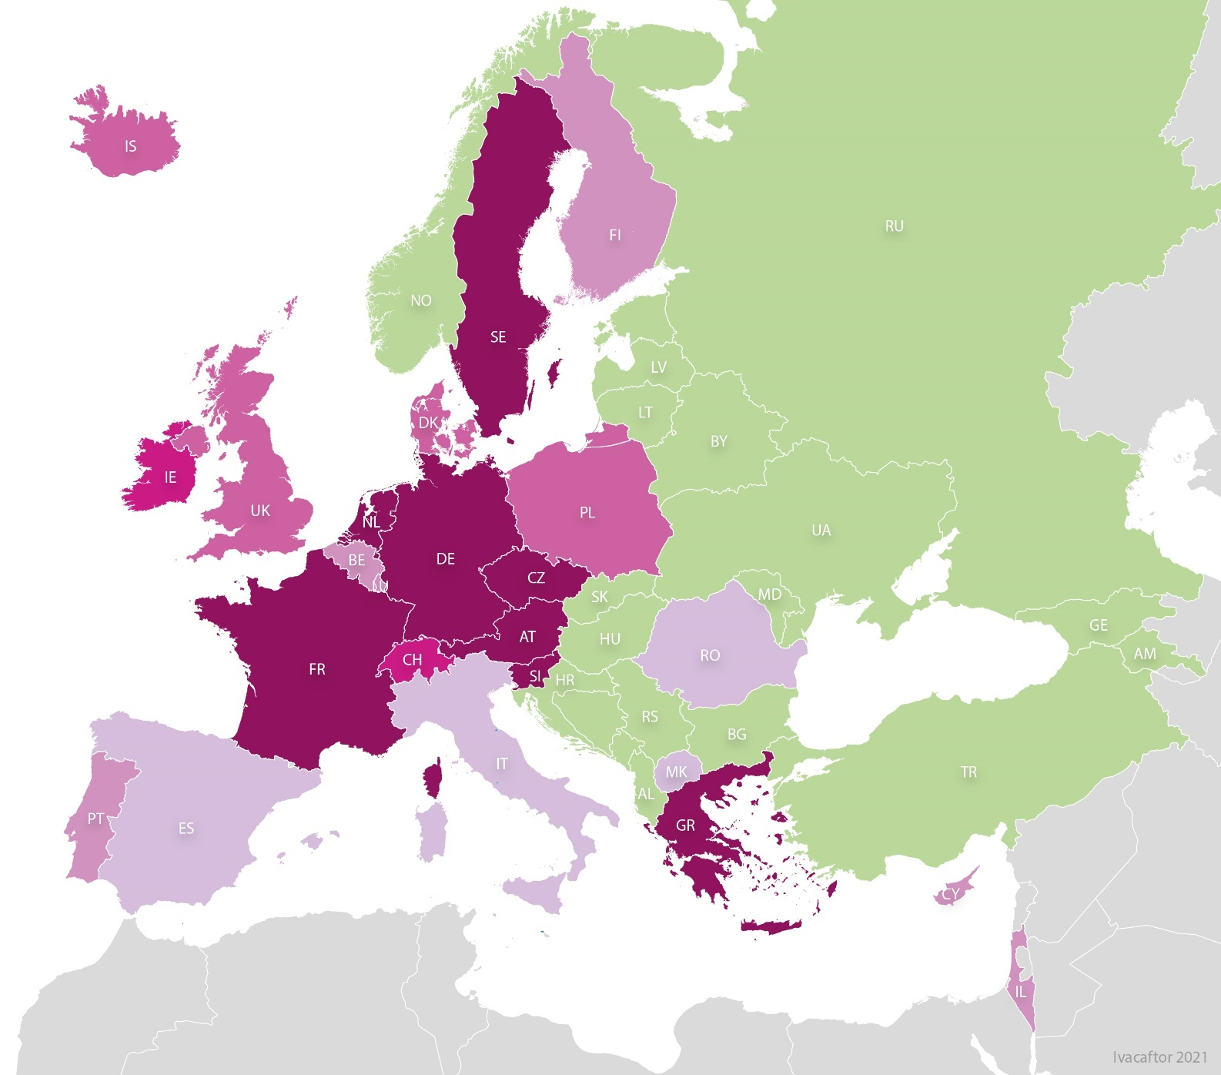
Figure 9.1
Countries where ivacaftor was licensed and reimbursed in 2021.
Note: Belgium: reimbursement only for people with two CF-causing variants or sweat chloride > 60mmol/L and with pulmonary or GI symptoms and/or growth deviation; excluded are people with R117H variant and people with a lung transplantation.
Israel: For people with the variant R117H there is no approval is required.
Sweden: no official reimbursement; the therapy is available through the healthcare system for people with the eligible CFTR variants (excluding R117H).
Switzerland and the United Kingdom: For people with the variant R117H it is reimbursed to people with CF if ≥ 18 years old.
ECFSPR Annual Report 2021, Zolin A, Orenti A, Jung A, van Rens J et al, 2023

Slide 72
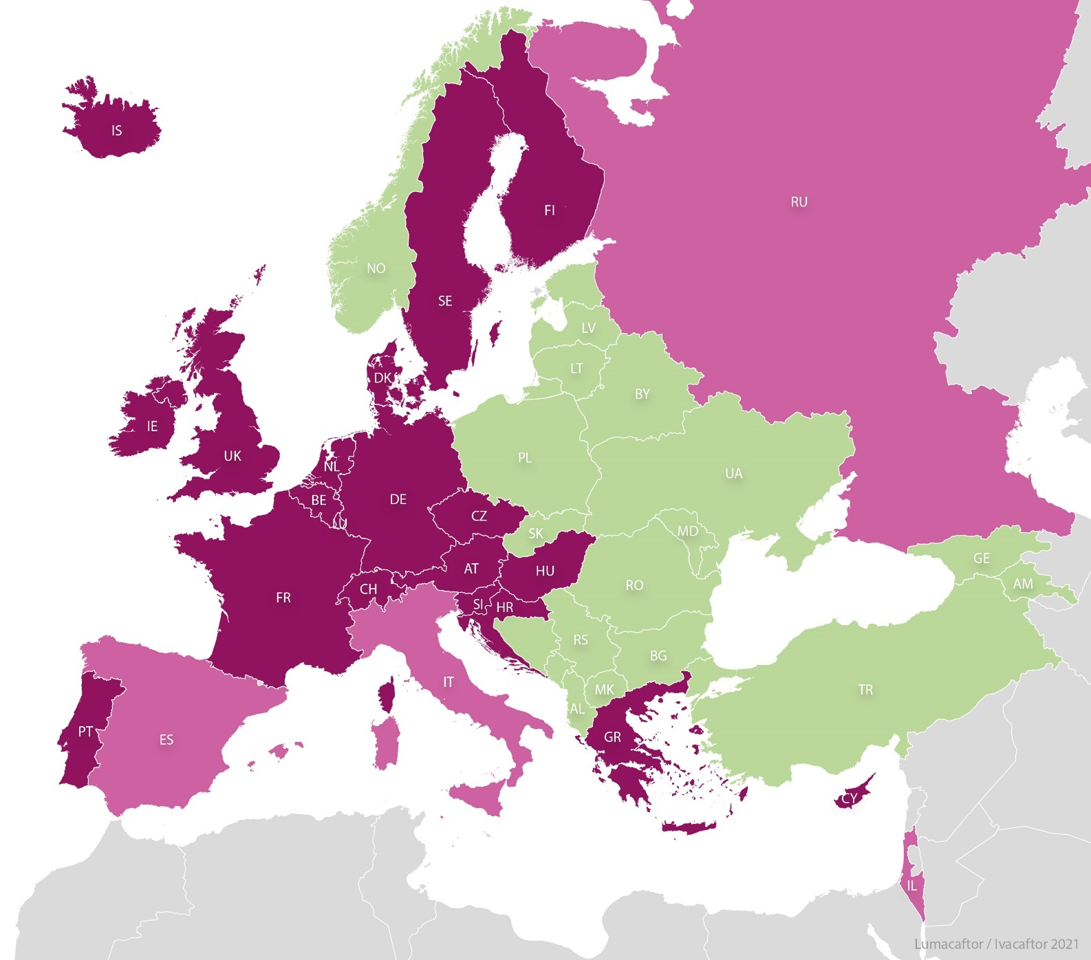
Figure 9.2
Countries where lumacaftor/ivacaftor was reimbursed in year 2021.
Note: Israel: reimbursement is for people with CF who are ≥6 years old.
The Russian Federation: reimbursement is for people with CF who are between 6 and 18 years old.
ECFSPR Annual Report 2021, Zolin A, Orenti A, Jung A, van Rens J et al, 2023

Slide 73
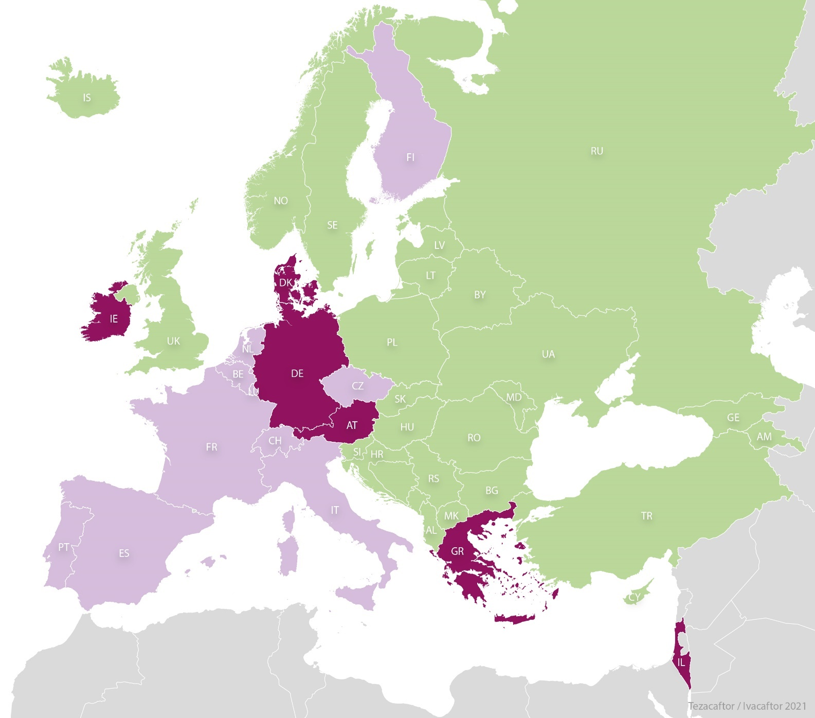
Figure 9.3
Countries where tezacaftor/ivacaftor was reimbursed in year 2021.
ECFSPR Annual Report 2021, Zolin A, Orenti A, Jung A, van Rens J et al, 2023

Slide 74
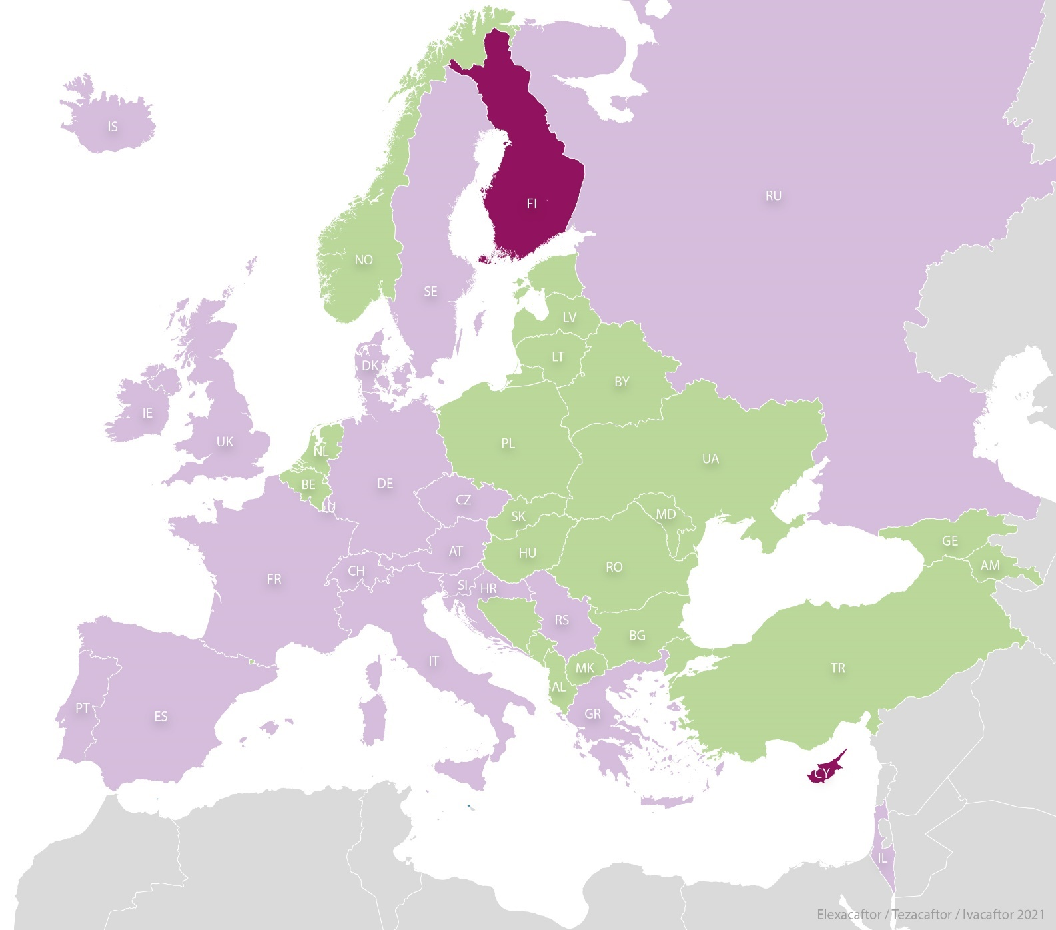
Figure 9.4
Countries where elexacaftor/tezacaftor/ivacaftor is licensed and reimbursed in year 2021
Note: The Russian Federation: reimbursement is for people with CF who are between 6 and 18 years old.
Sweden: the therapy is available in compassionate use only.
ECFSPR Annual Report 2021, Zolin A, Orenti A, Jung A, van Rens J et al, 2023

Slide 75
Figure 9.5
Lumacaftor/Ivacaftor is the predominant CFTR modulator in children, followed by the triple combination therapy.
People with CF eligible for at least one modulator, by country and last CFTR modulator, children seen in 2021 who had never had a transplant.
Note: Albania, Armenia, Belarus, Georgia, Iceland and Luxembourg have <5 eligible adults seen in 2021 and are excluded from the graph.
Note: United Kingdom: In the graphs of this report, we use GB as abbreviation for the United Kingdom of United Kingdom and Northern Ireland.
ECFSPR Annual Report 2021, Zolin A, Orenti A, Jung A, van Rens J et al, 2023

Slide 76
Figure 9.6
In the majority of countries in Europe, more than 50% of all adults with CF are now eligible to receive a CFTR modulator treatment.
People with CF eligible for at least one modulator, by country and last CFTR modulator, adults seen in 2021 who had never had a transplant.
Note: Albania, Armenia, Belarus, Georgia, Iceland and Luxembourg have <5 eligible adults seen in 2021 and are excluded from the graph.
Note: United Kingdom: In the graphs of this report, we use GB as abbreviation for the United Kingdom of United Kingdom and Northern Ireland.
ECFSPR Annual Report 2021, Zolin A, Orenti A, Jung A, van Rens J et al, 2023

Slide 77
CHAPTER 10
TRANSPLANTATION
www.ecfs.eu/pr

Slide 78
Figure 10.1
The number and proportion of people with CF living with a lung transplant is extremely heterogenous across Europe.
Number of people with CF living in 2021 with transplanted lungs, by country.
Note: United Kingdom: In the graphs of this report, we use GB as abbreviation for the United Kingdom of United Kingdom and Northern Ireland.
ECFSPR Annual Report 2021, Zolin A, Orenti A, Jung A, van Rens J et al, 2023

Slide 79
Figure 10.2
The number and proportion of people with CF living with a liver transplant is extremely heterogenous throughout Europe.
Number of people with CF living in 2020 with transplanted liver, by country.
Note: United Kingdom: In the graphs of this report, we use GB as abbreviation for the United Kingdom of United Kingdom and Northern Ireland.
ECFSPR Annual Report 2021, Zolin A, Orenti A, Jung A, van Rens J et al, 2023

Slide 80
CHAPTER 11
MORTALITY
www.ecfs.eu/pr

Slide 81
Figure 11.1
Most of the deaths occur between the third and the fifth decade of life in people with CF in Europe.
Age at death distribution of people with CF deceased in 2021, by sex.
Note: United Kingdom: In the graphs of this report, we use GB as abbreviation for the United Kingdom of United Kingdom and Northern Ireland.
ECFSPR Annual Report 2021, Zolin A, Orenti A, Jung A, van Rens J et al, 2023

Slide 82
CHAPTER 12
LONGITUDINAL DATA
www.ecfs.eu/pr

Slide 83
Figure 12.1
The number of countries and people with CF participating in the ECFSPR has risen continuously over the years.
Number of people with CF and number of countries from 2008 to 2021.
ECFSPR Annual Report 2021, Zolin A, Orenti A, Jung A, van Rens J et al, 2023

Slide 84
Figure 12.2
In recent years the proportion of adults with CF in Europe has risen significantly and as of 2021 adults were more than >50% of the total.
Number of people with CF and percentage of adults and children from 2008 to 2021.
ECFSPR Annual Report 2021, Zolin A, Orenti A, Jung A, van Rens J et al, 2023

Slide 85
Figure 12.3
In the last decade the proportion of children diagnosed with CF by newborn screening has increased to almost 90% throughout Europe.
Neonatal screening done in people with CF 5 years old or younger in the year of follow-up from 2011 to 2021.
ECFSPR Annual Report 2021, Zolin A, Orenti A, Jung A, van Rens J et al, 2023

Slide 86
Figure 12.4
Pulmonary function, as expressed by FEV1, has been increasing over the years in all age groups, with a sharper rise since the introduction of CFTR modulators.
Median FEV1% by age group in 2011, 2016 and 2021.
ECFSPR Annual Report 2021, Zolin A, Orenti A, Jung A, van Rens J et al, 2023

Slide 87
Figure 12.5
The prevalence of Pseudomonas aeruginosa infection decreased across the whole CF population in Europe since increased availability of highly effective CFTR modulators.
Prevalence of people with CF infected by Pseudomonas aeruginosa by age group in 2011, 2016 and 2021.
ECFSPR Annual Report 2021, Zolin A, Orenti A, Jung A, van Rens J et al, 2023

Slide 88
Figure 12.6
A significant improvement in BMI in 2021 from the age of 6 years is a reflection of the efficacy of CFTR modulator therapy in Europe.
Median z-score for BMI by age group in 2011, 2016 and 2021.
ECFSPR Annual Report 2021, Zolin A, Orenti A, Jung A, van Rens J et al, 2023

Slide 89
Figure 12.7
Increased use of CFTR modulators in children and adults with CF in Europe goes hand in hand with a decrease in the prescription of azithromycin and inhaled antibiotics, while the prevalence of inhaled mucolytics remains mostly unchanged.
Median z-score for BMI by age group in 2011, 2016 and 2021.
ECFSPR Annual Report 2021, Zolin A, Orenti A, Jung A, van Rens J et al, 2023

Slide 90
Figure 12.8
Increased use of CFTR modulators in children and adults with CF in Europe goes hand in hand with a decrease in the prescription of azithromycin and inhaled antibiotics, while the prevalence of inhaled mucolytics remains mostly unchanged.
Use of therapies among adults from 2011 to 2021.
ECFSPR Annual Report 2021, Zolin A, Orenti A, Jung A, van Rens J et al, 2023

Slide 91
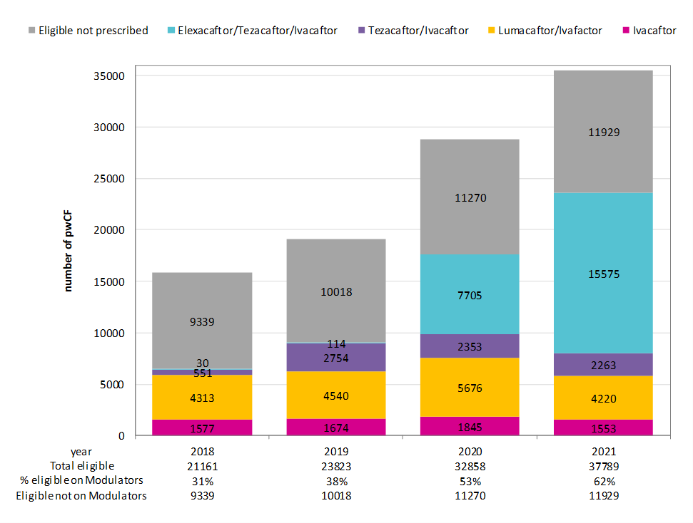
Figure 12.9
Availability of elexacaftor/tezacaftor/ivacaftor in Europe has meant a considerable increase in CFTR modulator utilisation in 2020 and 2021.
Use of therapies among adults from 2011 to 2021.
ECFSPR Annual Report 2021, Zolin A, Orenti A, Jung A, van Rens J et al, 2023

